Slide 1


An Introduction to
SafetyOn
In partnership with
Notes:
Version: 1
Last updated: February 2026

Slide 2


SafetyOn: An Overview
In partnership with
Thank you for your interest in SafetyOn.
In this short introduction you will learn about:
Incident Data
Safe by Design
Good Practice Guidelines
Shared Learning From Incidents
Wind Turbine Safety Rules
Work Programme
Campaigns
Organisation
Mission & Purpose
How we work
Our Members
Join Us
Find Out
More

Slide 3
Focus on Health & Safety
Not-for-profit, member-led collaboration for the UK&I onshore wind sector.
Our mission is to inspire a safer and healthier onshore wind industry in the UK and Ireland.
We do this by providing advice, sharing best industry practice, promoting innovation and creating positive change in the UK and Ireland’s onshore wind industry.
Facilitated by the Energy Institute (secretariat).
Industry leaders, experts, regulators and supply chain companies.
Gather and monitor data on industry health and safety performance.
Share good practice and experience.

Slide 4
Our Members and Stakeholders
SafetyOn’s membership spans the Onshore Wind sector and beyond.
We drive community and collaboration within the sector, with key stakeholders and with adjacent sectors, such as Offshore Wind and Construction.
Owners and Operators
Wind turbine Manufacturers
Supply chain / service companies
Industry bodies

Slide 5




















Members
Notes:
Correct as of Jan 2026

Slide 6
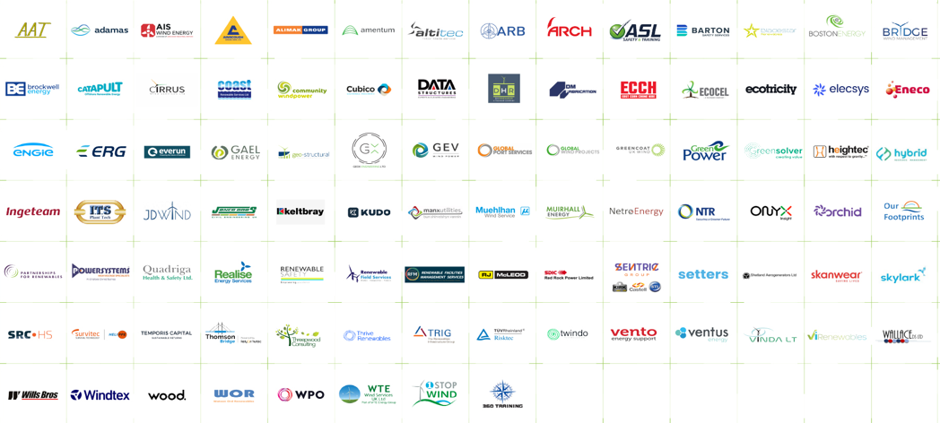



Associate Members
Notes:
Correct as of Jan 2026

Slide 7
Governance & Organisation
Secretariat:
Energy Institute
Technical Manager:
Emma McIvor
Data Manager:
Edwin Sheppard
Technical Officers:
Andrea Pantoja
Mohammed Rashaad
Tamzeed Karim
Leadership Board
Chair: Darren Taylor, SGRE
Vice Chair: Joe Mitchell, SPR
Anders Falkfjell, Fred Olsen Renewables
Andy Bilclough, OnPath Energy
Billy Stevenson, Full Circle
Darren Cook, RES
Dean Burgess, RWE
Dennis Geyermann, Statkraft
Ewan Park, Natural Power
Heather Chambers, Vantage RE
James Robottom, RenewableUK
John Gates, Vattenfall
John Morris, Nadara
Mark Byrne, Enercon Services Ltd
Mark MacDonald, SSE Renewables
Martin Maeso, Energy Institute
Michael Short, Nordex
Peter Woodroffe, GE
Piero Maggio, EDF Renewables
Stephen Ford, Vestas
Stewart Reid, BayWa r.e.
Technical Advisory Committee (TAC)
Chair:
Jason Day, EDF
Vice Chair:
Gareth Piggot, SPR
Notes:
Correct as of Jan 26

Slide 8






Work Programme
Incident Data
Safe by Design
Good Practice Guidance
Safe by Design
Member companies submit incident data each quarter. This data is instrumental in developing industry-wide standards and guidance.
Bringing experts together, specific topics are investigated with the objective of making improvements at the design stage that will help to reduce incidents.
One of our main functions is to develop guidance through collaboration. It is implemented within member companies and beyond.
Bringing experts together, specific topics are investigated with the objective of making improvements at the design stage that will help to reduce incidents.
Shared Learning
From Incidents
Wind Turbine Safety Rules
Campaigns
We drive engagement and collaboration with stakeholders, and we create resources to support member companies.
A model set of Safety Rules and procedures to help formalise a Safe System of Work to manage the significant risks associated with a wind turbine.
Communication materials to drive awareness and knowledge of specific safety-related topics.

Slide 9


Incident Data
Each year, SafetyOn publishes a detailed analysis of health and safety performance within the UK and Ireland onshore wind industry.
The analysis highlights key risk areas and trends and shapes SafetyOn’s work programme, by indicating those activities where improvements are required.
The data can be viewed in the report or interrogated using a Power BI dashboard.
Access to the data is free and unrestricted.
This is based on quarterly data submitted by SafetyOn Member companies, using an agreed standard template.
Download
Incident Data from
Safetyon.com.

Slide 10

Safe By Design
Brings experts together for the purpose of getting the best practice in health and safety into design.
Topics investigated with the objective of making improvements at the design stage that will help to reduce incidents throughout the lifecycle of an onshore wind farm.
Recent topics include:
Electrical Safety
Ice fall and ice throw
Chain Hoists
Access to the Workshop Reports is free and unrestricted.
High risk topics identified by the SafetyOn incident data, input from members and wider industry consultation.
Download SbD
Workshop Reports

Slide 11

Good Practice Guidance
We develop guidance through cooperation and shared learning, supported by the Energy Institute Technical team.
As a member led organisation, we ensure that the guidance we publish is representative of the entire industry.
Where appropriate, we collaborate with other member organisations, such as G+.
We work to ensure that the guidance is implemented within our member organisations and promoted to the wider industry.
Topics identified in collaboration with members and other stakeholders. Incident Data is a key input.
Download
Good Practice Guidance

Slide 12
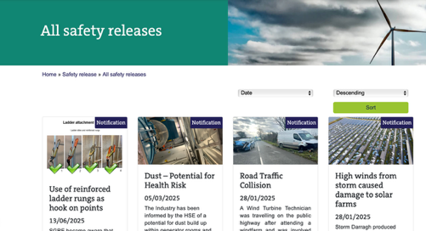
Shared Learning From Incidents
SafetyOn is committed to sharing health and safety information and lessons learnt.
Our aim is to help prevent incidents occurring elsewhere in the industry.
Safety Releases are categorised as:
All Safety Releases are shared through our website and socials.
Safety Alert:
Important - action required.
Safety Notification:
Information only.
Access Safety Releases
Safety Bulletin: Technical notification (equipment or process).

Slide 13

Wind Turbine Safety Rules
A model set of Safety Rules and procedures to help formalise a Safe System of Work (SSoW) to manage the significant risks associated with a wind turbine.
Designed to achieve:
Developed by wind farm owners and operators.
The general direction of the Rules will be set jointly by SafetyOn and G+.
General safety: A process that safeguards persons from the mechanical plant and LV apparatus.
Safety from the system: The associated system-derived hazards.
Download WTSR
BACK TO WORK PROGRAMME

Slide 14
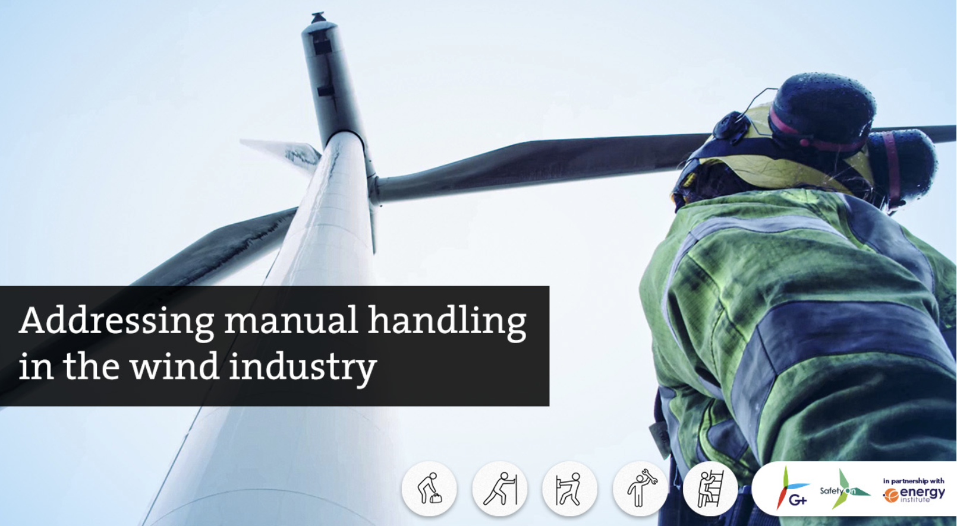
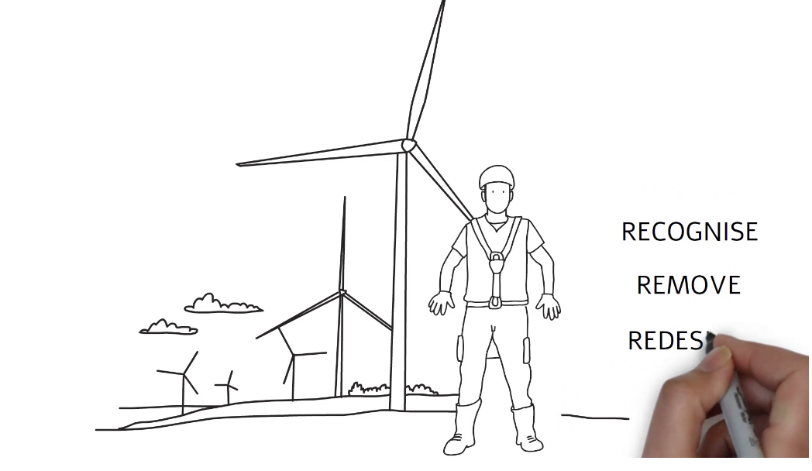
Campaigns
Topics identified for awareness and additional focus.
View Manual Handling
campaign materials
View Hand Injuries
campaign materials
Members
Campaign materials developed by SafetyOn with input from experts.
Industry data
HSE and other stakeholders
Available for use by any organisation free of charge.
BACK TO WORK PROGRAMME

Slide 15
Active workstreams for 2026
Good Practice Guidance
Safe by Design
Shared Learning From Incidents
Incident Data
Wind Turbine Safety Rules
Campaigns
First Aid Provision
Non-destructive testing
Ice fall / ice throw
Integrity management
of fasteners for life extension
Structural integrity of foundation for life extended assets
Occupational Health
Security issues
WTG Life Extension Hazid
Workshop report: PD & risk management
Safety Alerts
Safety Notifications
Safety Bulletins
2025 incident data report
Wind Turbine System Safety Rules
2026/27 ice fall / throw data campaign
Incident data
Visit the SafetyOn website for resources and downloads

Slide 16
Be part of SafetyOn
SafetyOn encourages participation from all industry stakeholders. We offer different types of membership to reflect the diverse range of organisations active within the industry.
Is your company either of the following:
An O&M Service Provider or Contractor with a minimum 200MW portfolio, or:
An OEM with a minimum of 200MW delivered and operational capacity.
YES
NO

Slide 17
Joining SafetyOn as a Member
SafetyOn Membership delivers a range of valuable benefits.
Representation and voting rights on Leadership Board and Technical Advisory Committee.
Participation in workgroups.
Opportunity to shape SafetyOn strategy and work plans.
Recognition as a leading voice in the industry.
For membership enquiries: safetyon@energyinst.org.

Slide 18
Joining SafetyOn as an Associate Member
SafetyOn Associate Membership delivers a range of valuable benefits.
Part of an expert network, including participation at SafetyOn events.
Provide expert input, guidance and direction to industry.
Opportunity to participate in workgroups and provide solutions.
Recognition as a leading voice in the industry.
For membership enquiries: safetyon@energyinst.org.

Slide 19
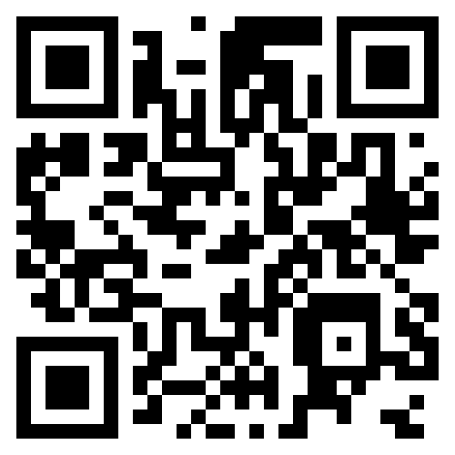
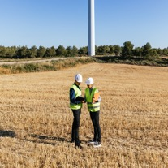
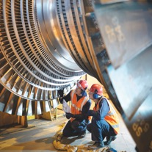


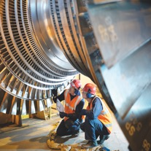

Thank you for your interest in SafetyOn
Visit the website for more information.
Contact us: safetyon@energyinst.org.
Sign up for regular updates on our work.
Find out how Energy Institute membership could help you.

Slide 20



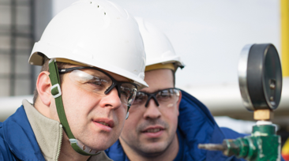

Explore Energy Institute membership
Whether you’re just starting out, established in your career or looking to support teams with training and accreditation, there is an Energy Institute membership to benefit you. We’ll help you choose the membership that matches your needs.
You can also apply for professional registration alongside our professional membership grades.
Find your membership path
Individual Memberships
Professional Registration
/ Chartership
Corporate Memberships

