Slide 1


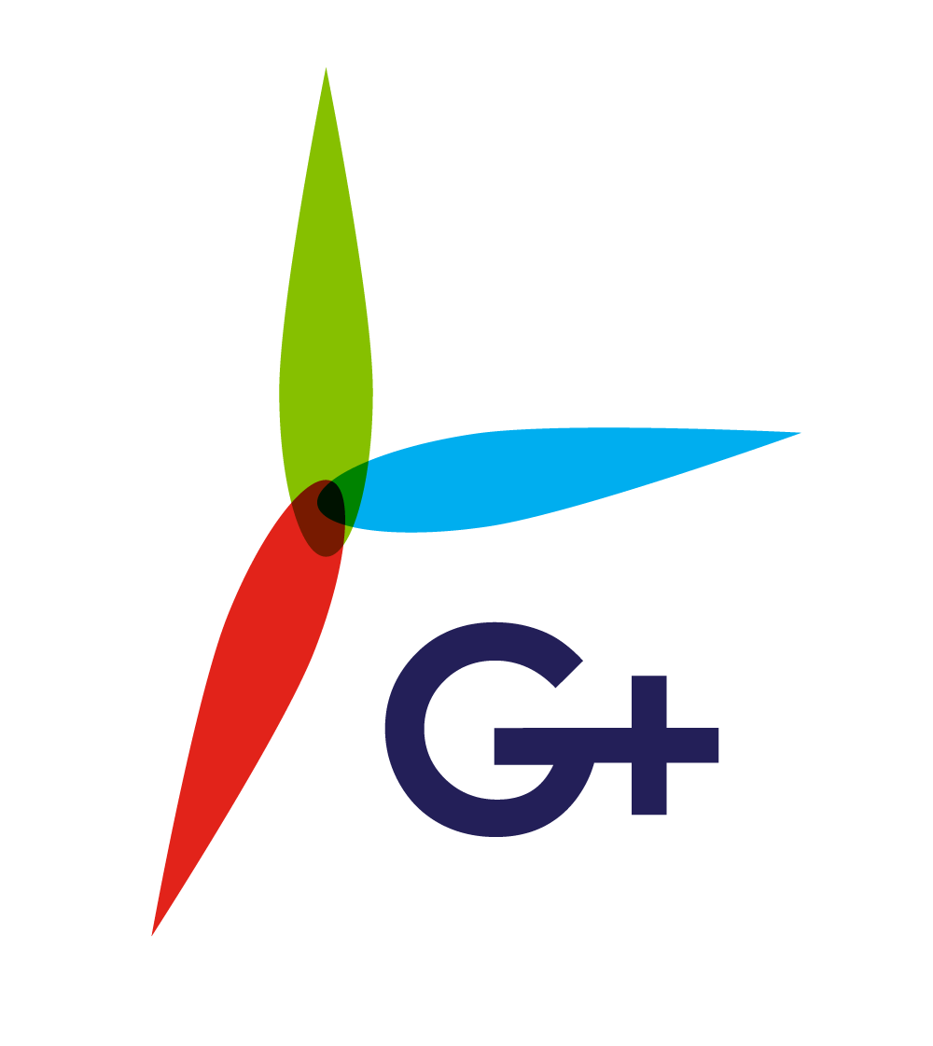
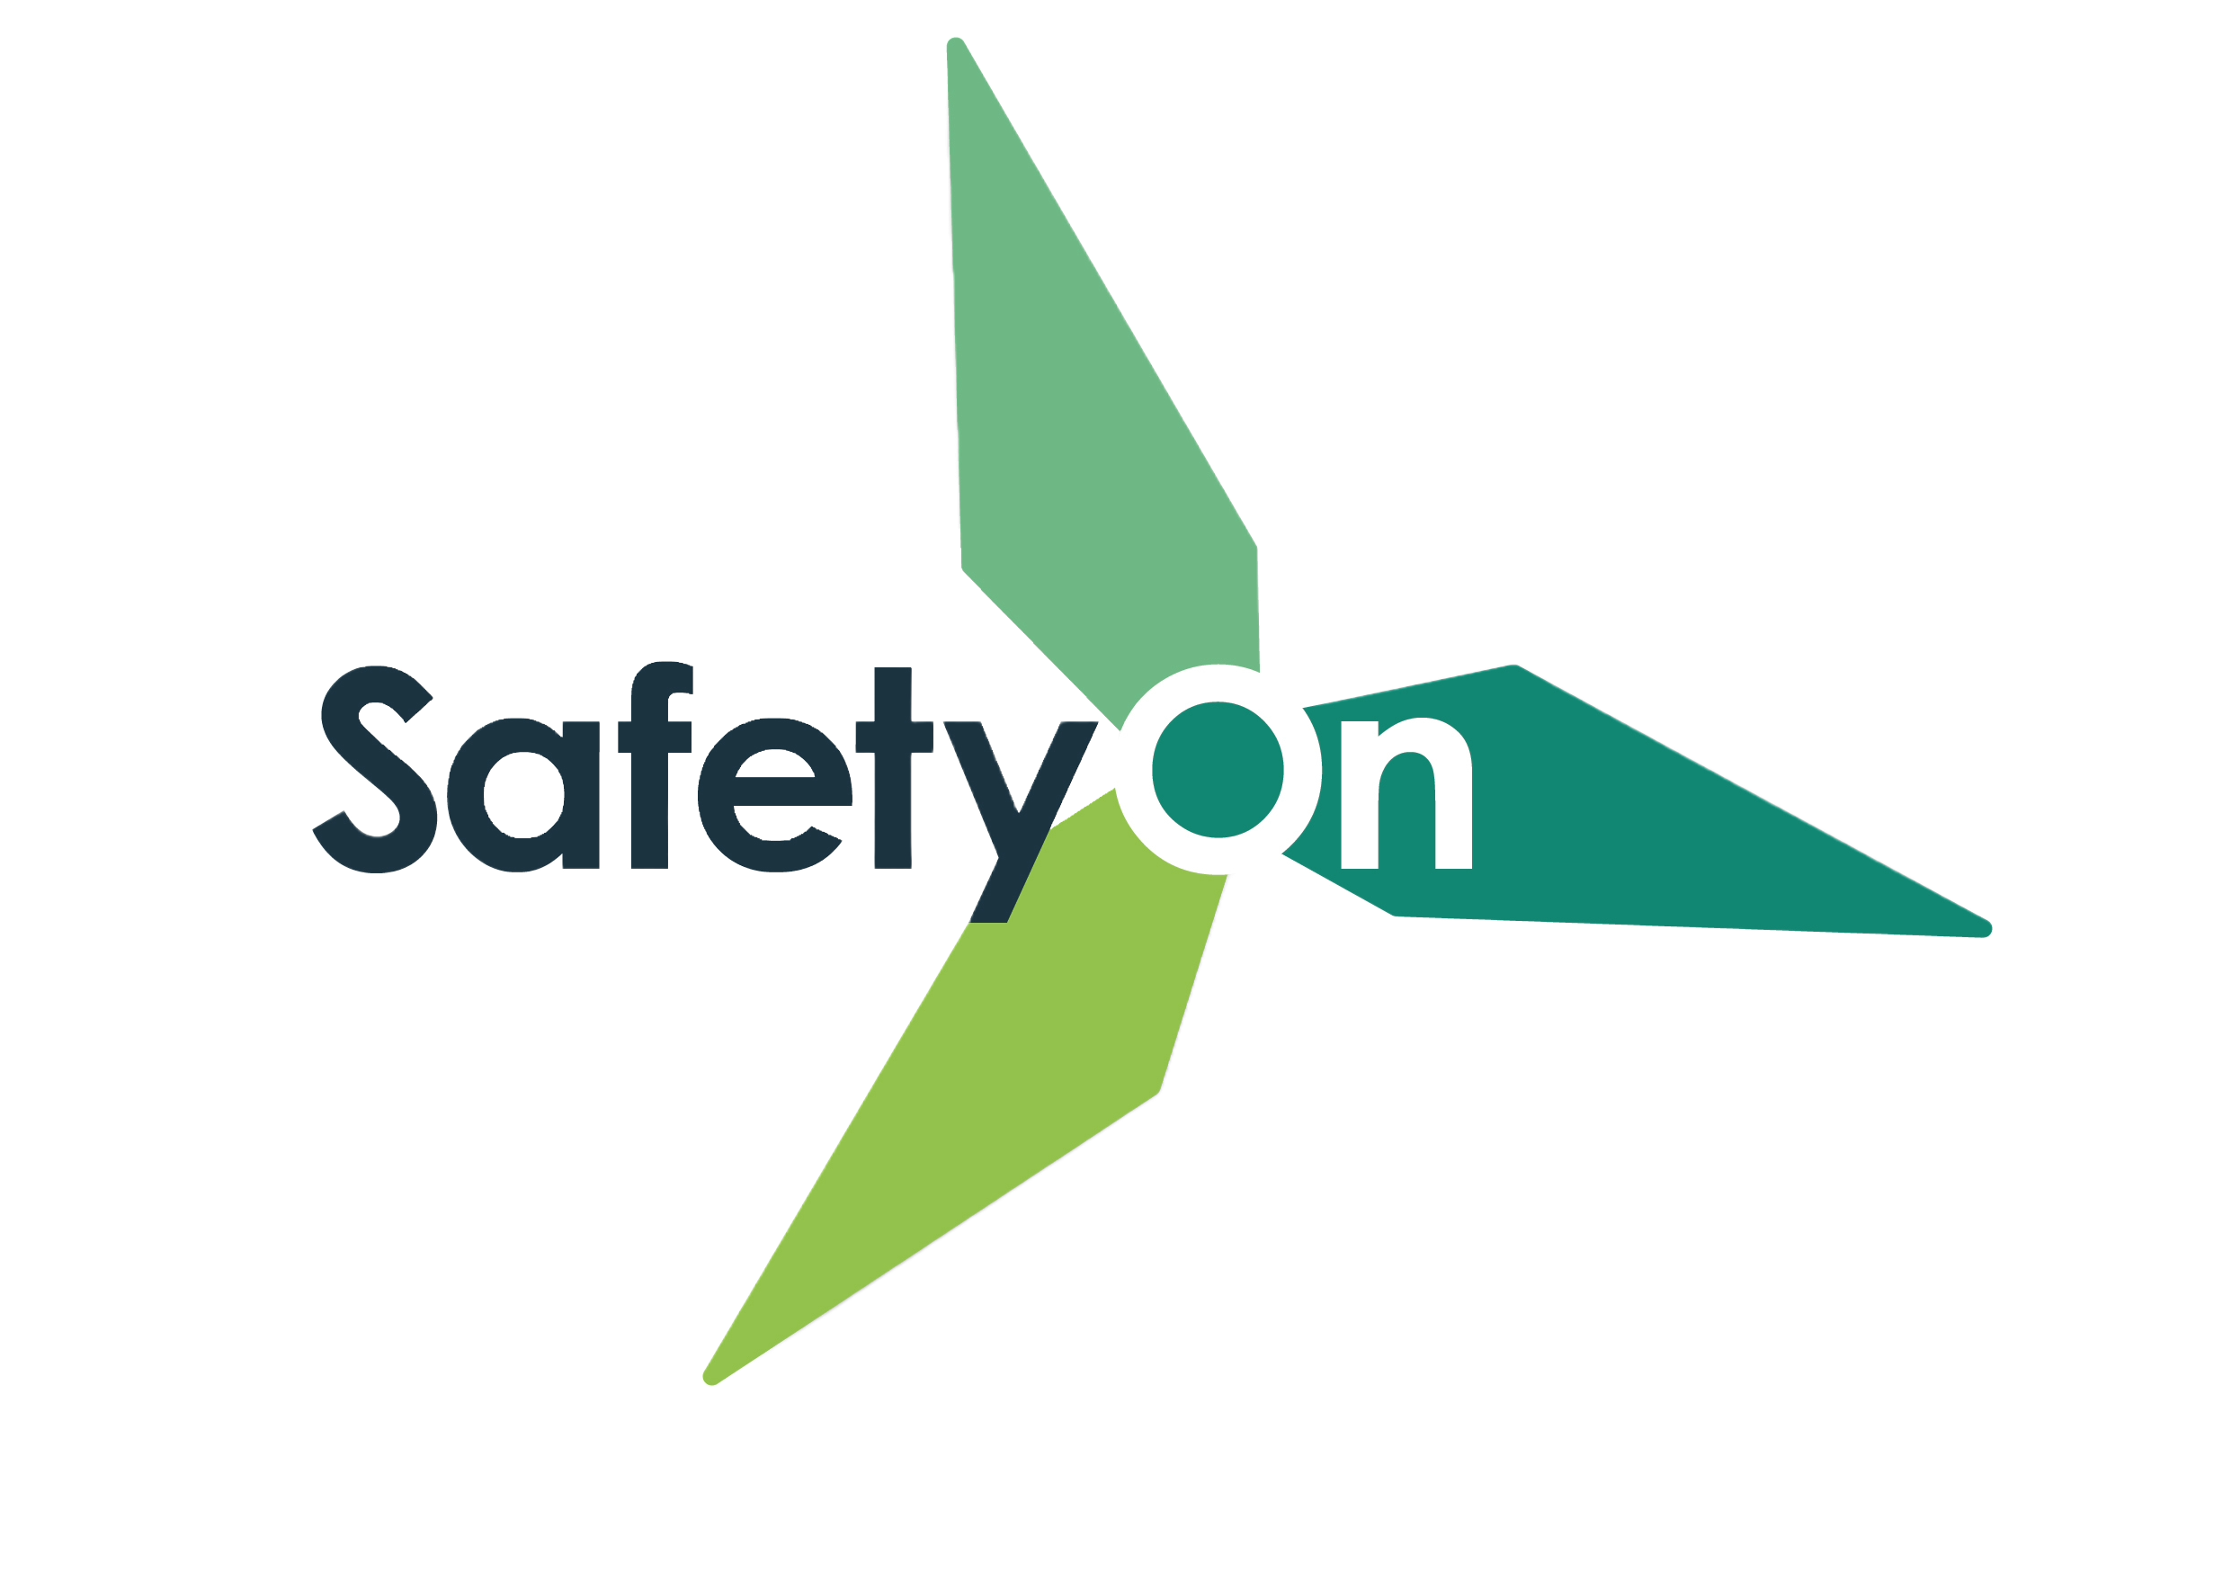
Addressing Manual Handling in the Wind Industry
Toolbox Talk 3: Designing out risk

Slide 2
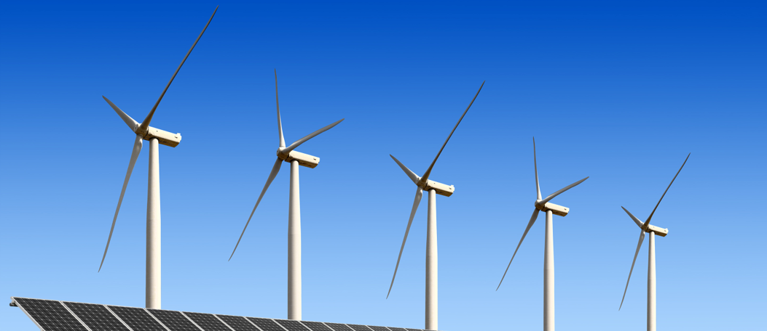
About SafetyOn
About G+
Inspiring a safer and healthier onshore wind industry
Global Offshore Wind Health and Safety Organisation
Providing advice, sharing best industry practice, promoting, innovation and creating positive change in the UK and Ireland’s onshore wind industry
Driving world class health and safety performance through collaboration on incident reporting, good practice, improving design safety and sharing lessons from incidents
Find out more at safetyon.com
Find out more at gplusoffshorewind.com
Notes:
SafetyOn
Provide health and safety leadership across the onshore wind industry
Seek participation of companies from across the onshore wind industry and partner with relevant trade organisations, consultancies and others
Monitor and gather data on the health and safety performance of the industry
Make use of and ensure effective communication of new and existing good practice and experience both from the UK, Ireland and internationally
Share knowledge and good practice with associated industries, including offshore wind, conventional generation and power networks, in the UK, Ireland and beyond as appropriate
G+
G+ is the global health and safety organisation, bringing together the offshore wind industry to pursue shared goals and outcomes. It is run in partnership with the Energy Institute, which provides the secretariat and supports its work.
The G+ main work areas:
Incident data reporting
Good practice guidance
Safe by Design workshops
Learning from incidents
Wind Turbine Safety Rules
Lifesaving Rules

Slide 3
Why manual handling?
Manual handling encompasses a wide range of incidents, with many crossovers and misconceptions. It is the leading cause of injuries in the wind industry, both on and offshore.
This video campaign aims to illustrate these incidents, suggesting good practice, rooted on actual on-site experience and reflective of all phases of projects both for the onshore and offshore wind industry.

Slide 4
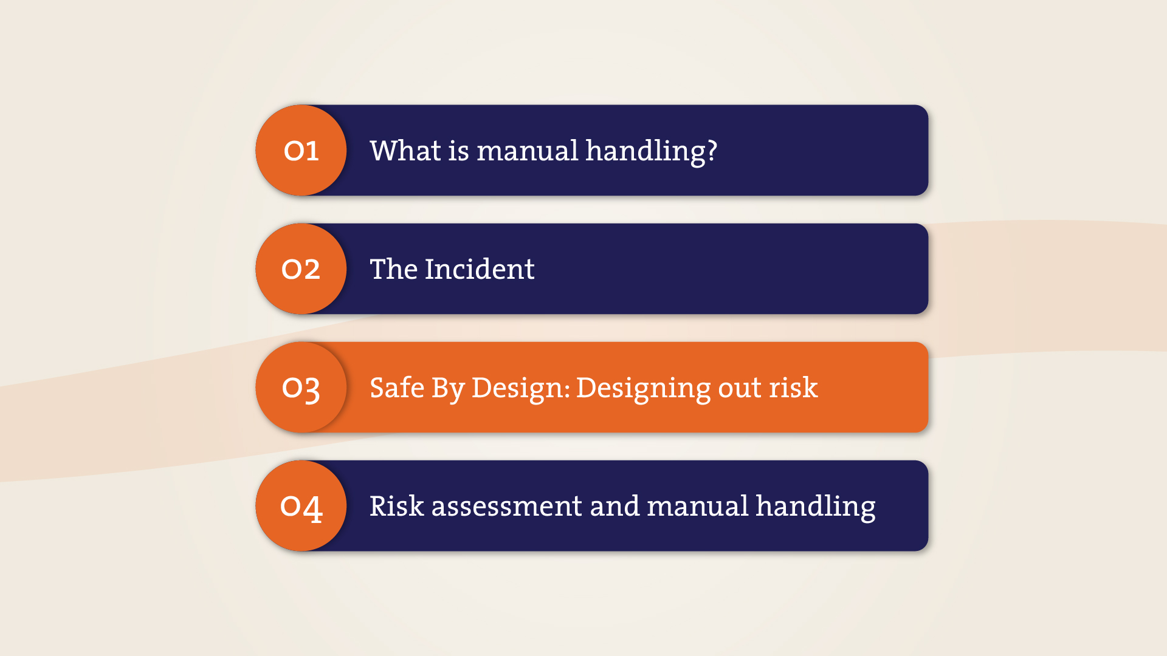

Slide 5
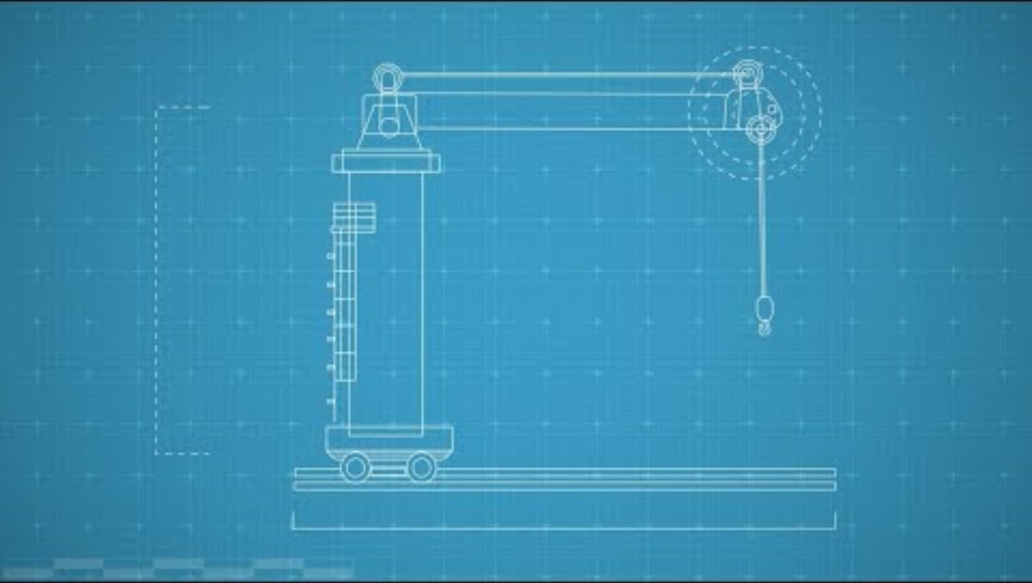
Designing out risk

Slide 6
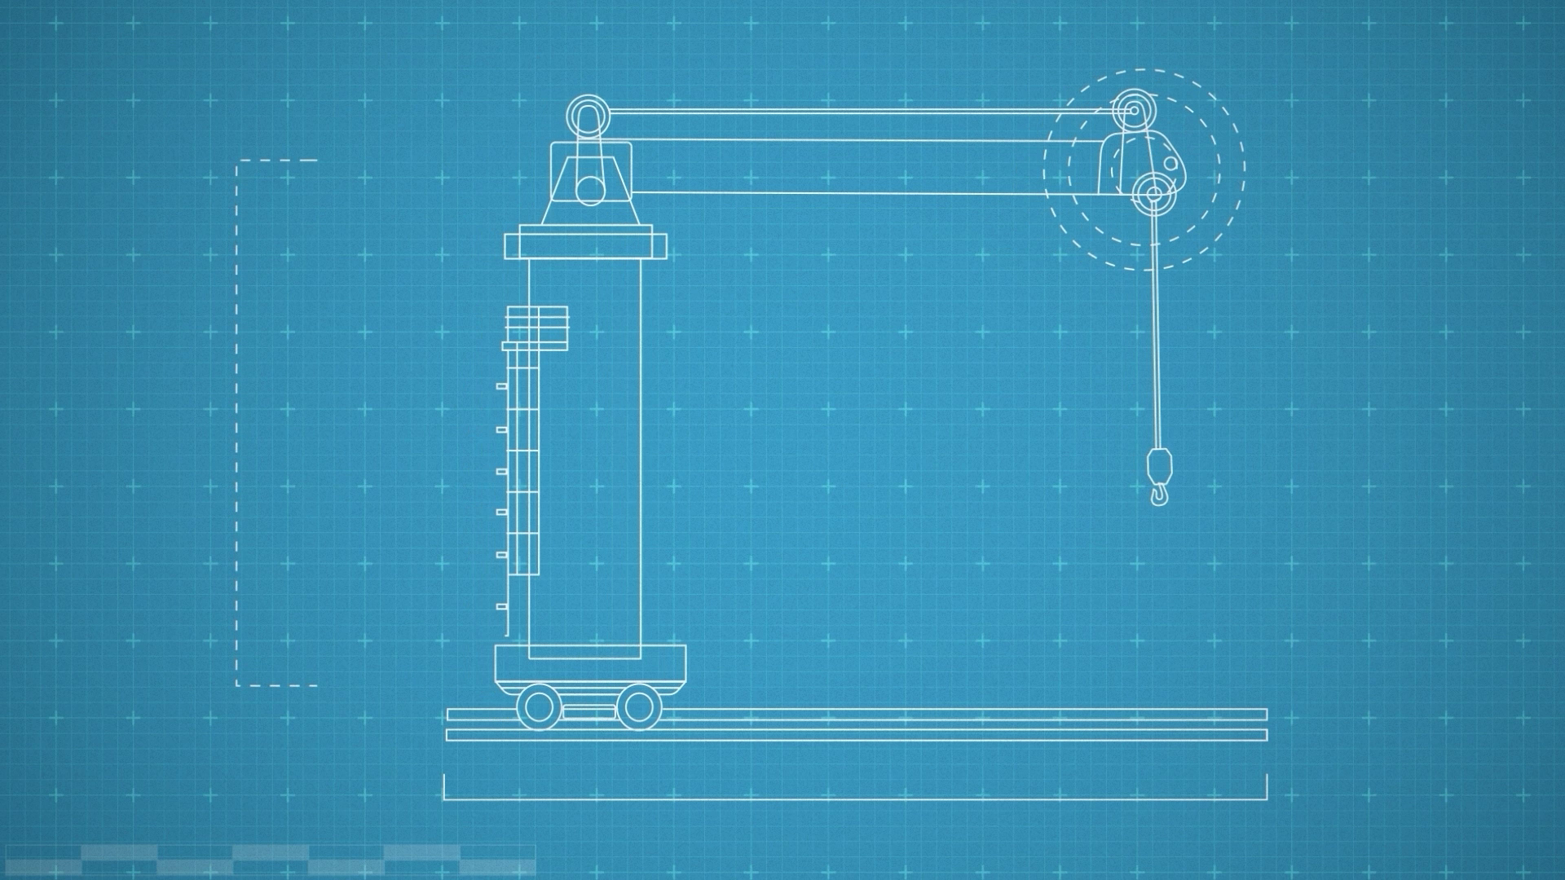
Toolbox Talk
Designing out risk
When have you discovered a design flaw on site, with manual handling implications?
What should you do if you find yourself unable to complete a task with the mechanical aids provided?
How would you feedback this information to improve future designs?
How could the team and company improve this feedback loop?
Notes:
Additional questions to encourage discussion:
Where was the design issue located? On the turbine? Vessel? Warehouse? What could be done about it?
What temporary solutions could be considered in the interim? How would you address it with your team? If there are no alternatives to alleviate the manual handling risk, what should you do? Could a task present a risk to specific individuals (eg if there is a height difference, for one example) what would you do then?
Who could you tell? If you communicate this with your supervisor (or equivalent), how should they feed it back up the chain to improve future designs? Have you seen this happen?
Do you feel the feedback loop is transparent enough? Is it possible to track the progress of your feedback? Do you feel comfortable sharing improvements with your team and superiors?

Slide 7




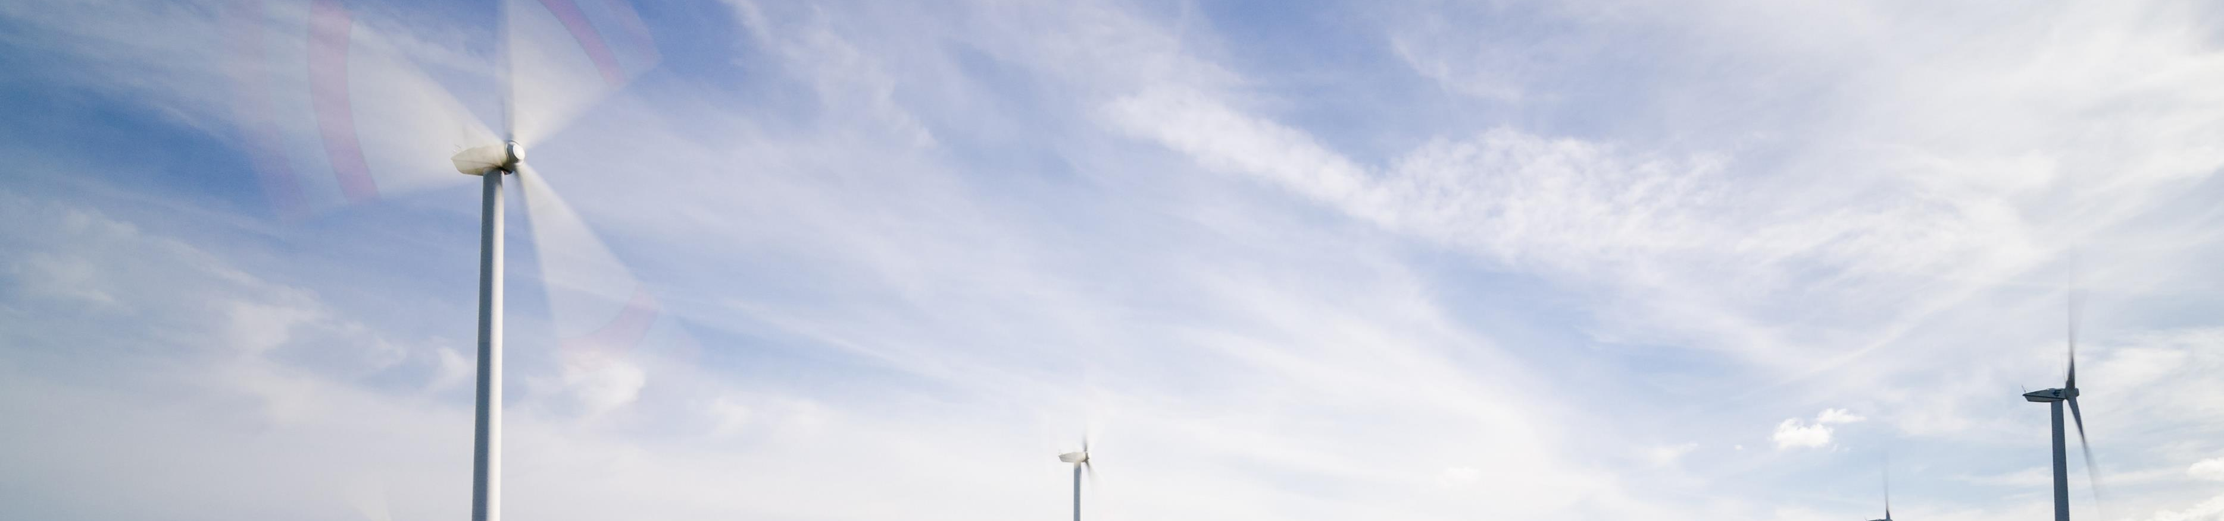
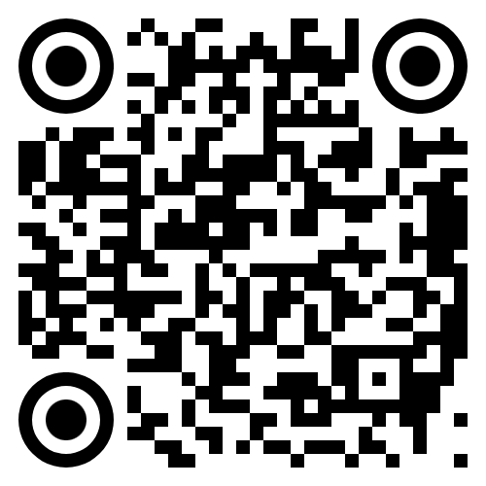
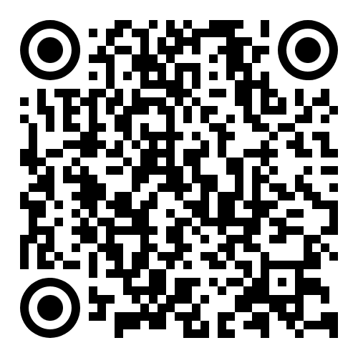
www.safetyon.com
@SafetyOnTweets
@SafetyOn
safetyon@energyinst.org
www.gplusoffshorewind.com
@gplusglobalofw
@G+ Global Offshore Wind Health and Safety Organisation
gplus@energyinst.org
Sign up for our newsletters

