Slide 1
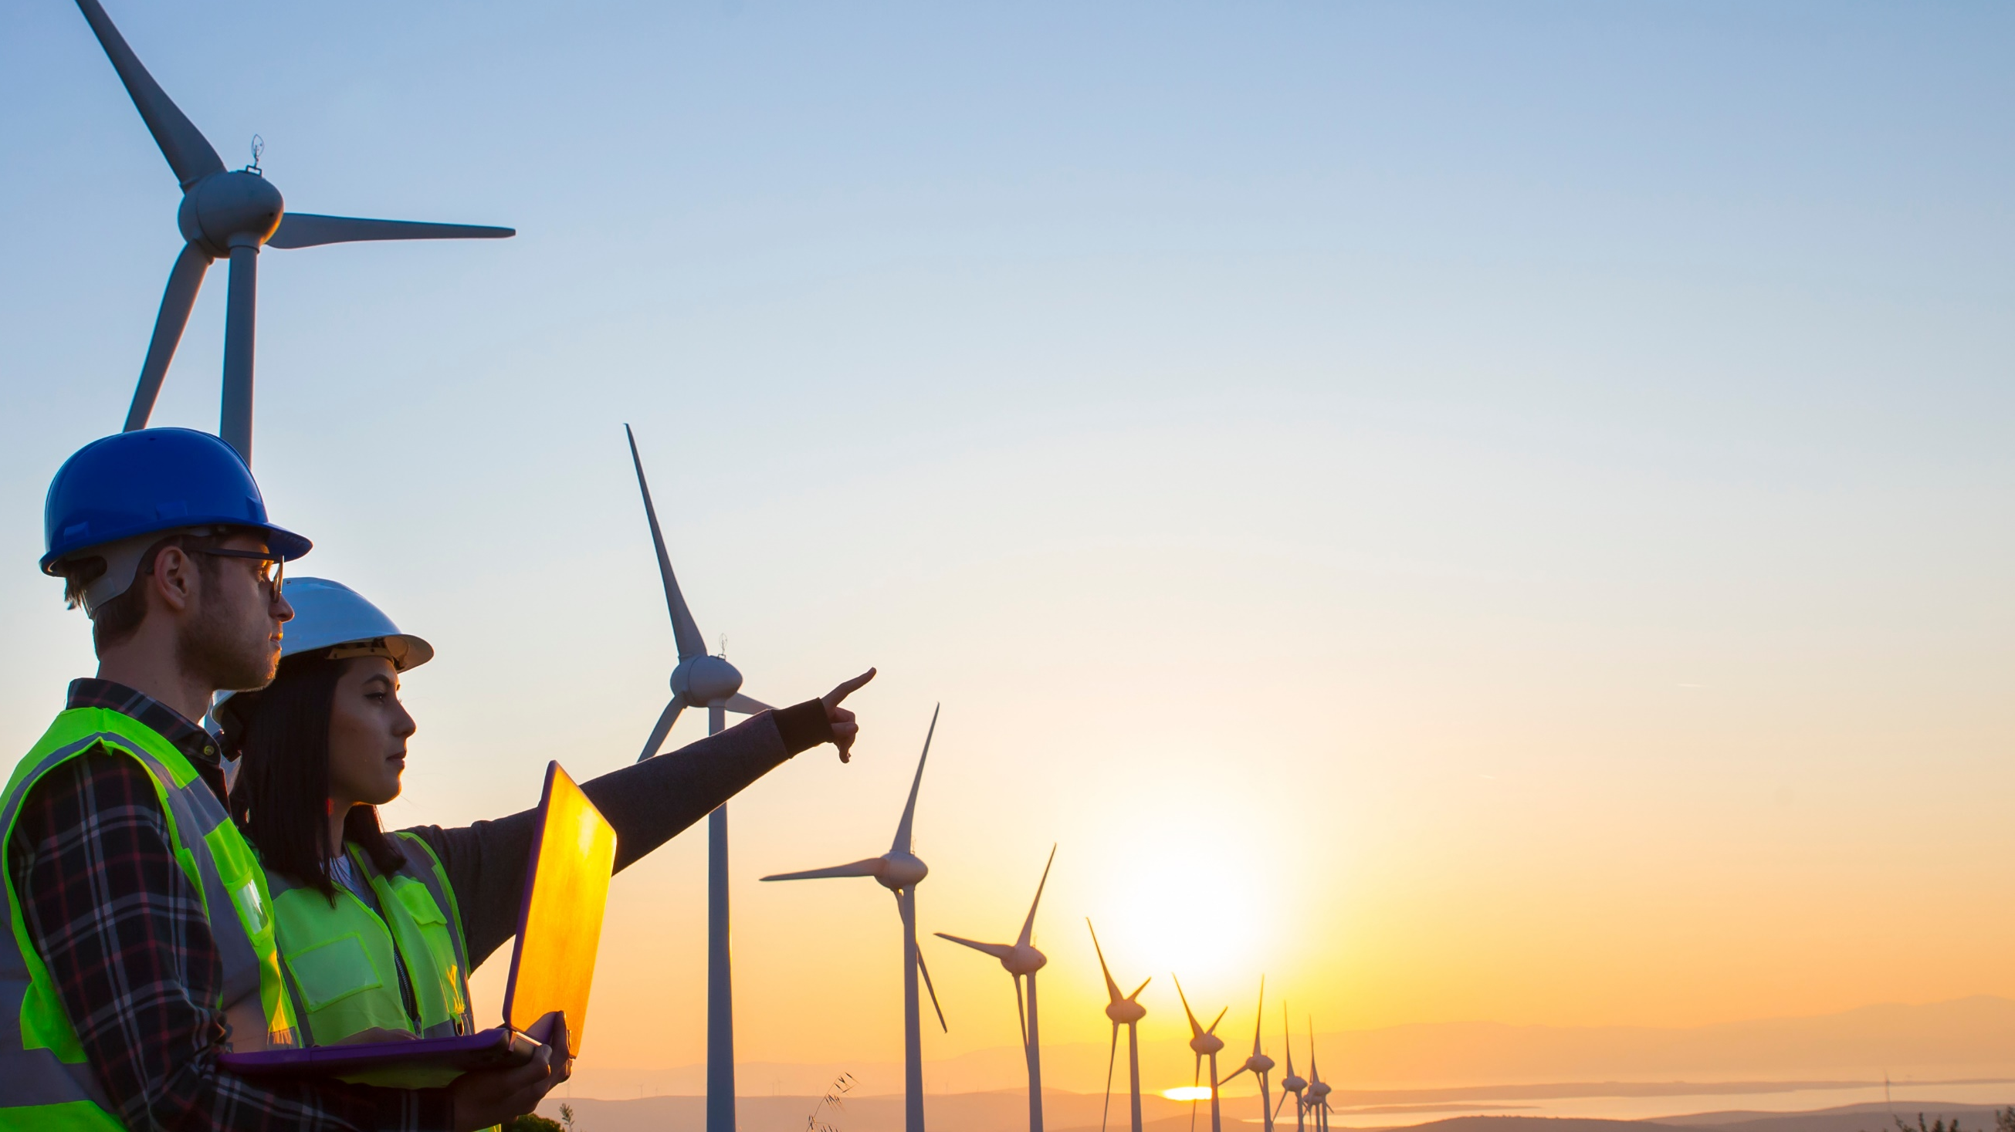

Thank you for being part of
Stand Up For Safety Week
Stand Up For Safety Week is dedicated to creating time to discuss hazards working onshore and preventative measures that could be taken to reduce risk to health and safety.
Stand Up For Safety Week

Slide 2
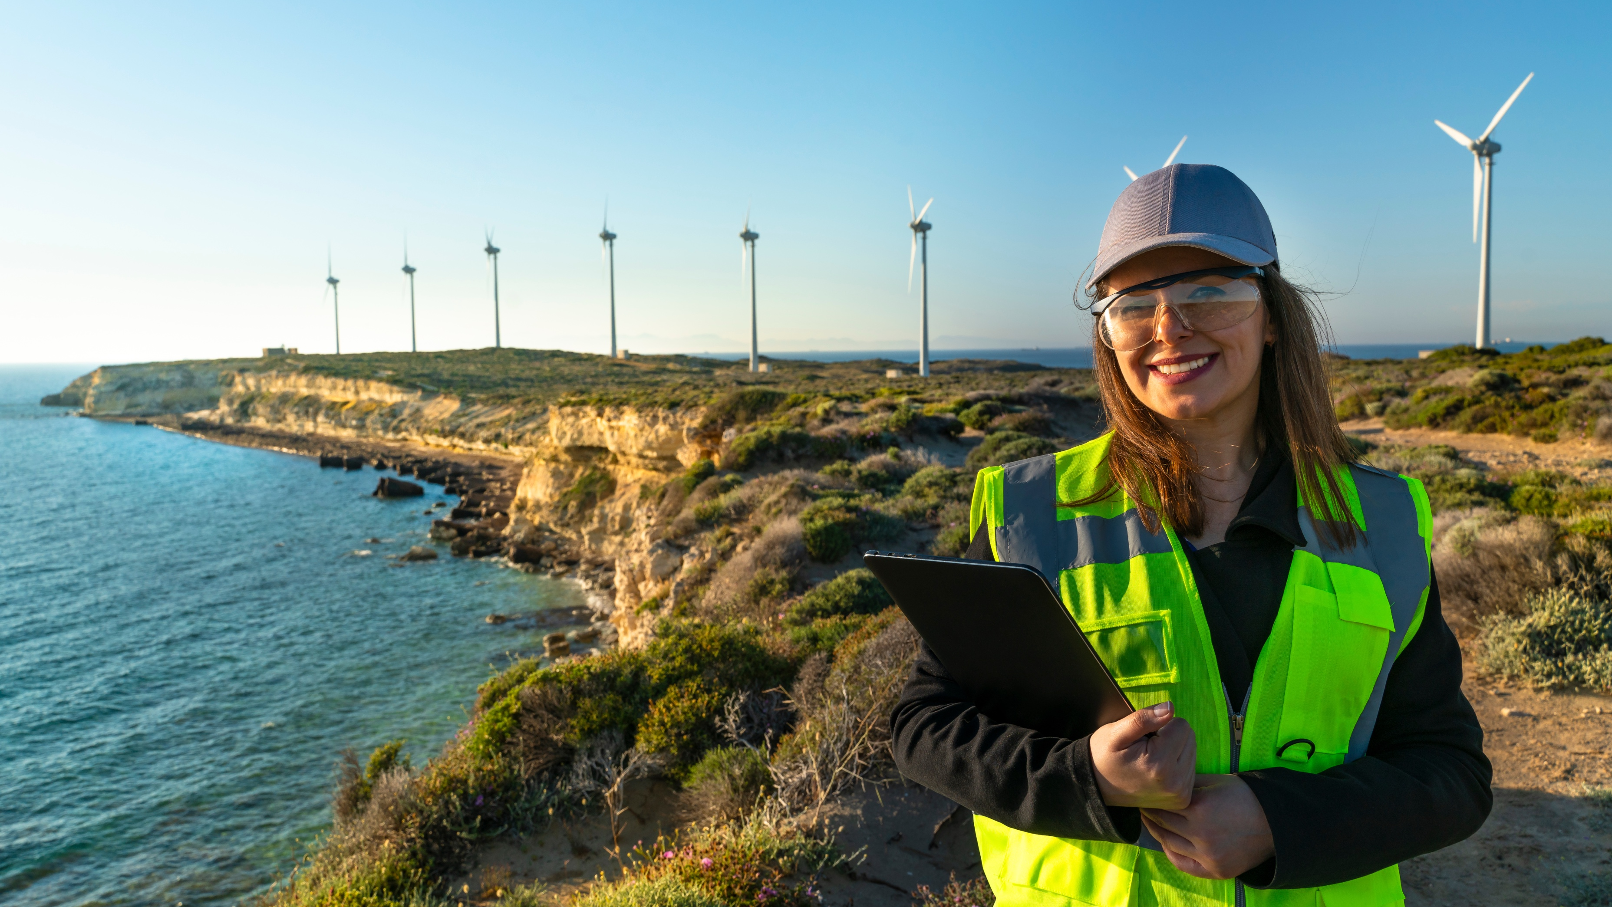
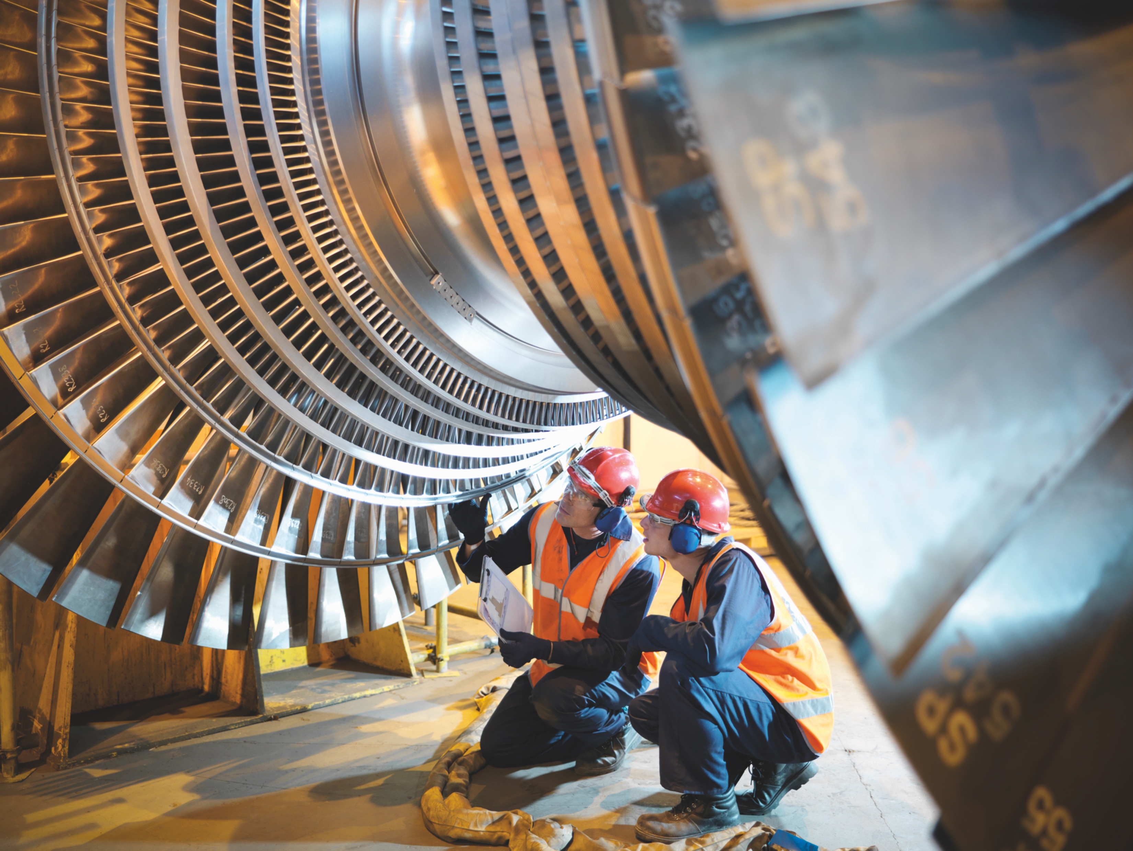
SUFS Briefing Pack:
Hand Injuries video series
Thank you for taking time out to Stand Up For Safety.
Hand Injuries can be
life-changing or have lifelong impacts.
In this session:
Intro to Hand Injuries
Video series
Discussion questions
Links to additional resources

Slide 3
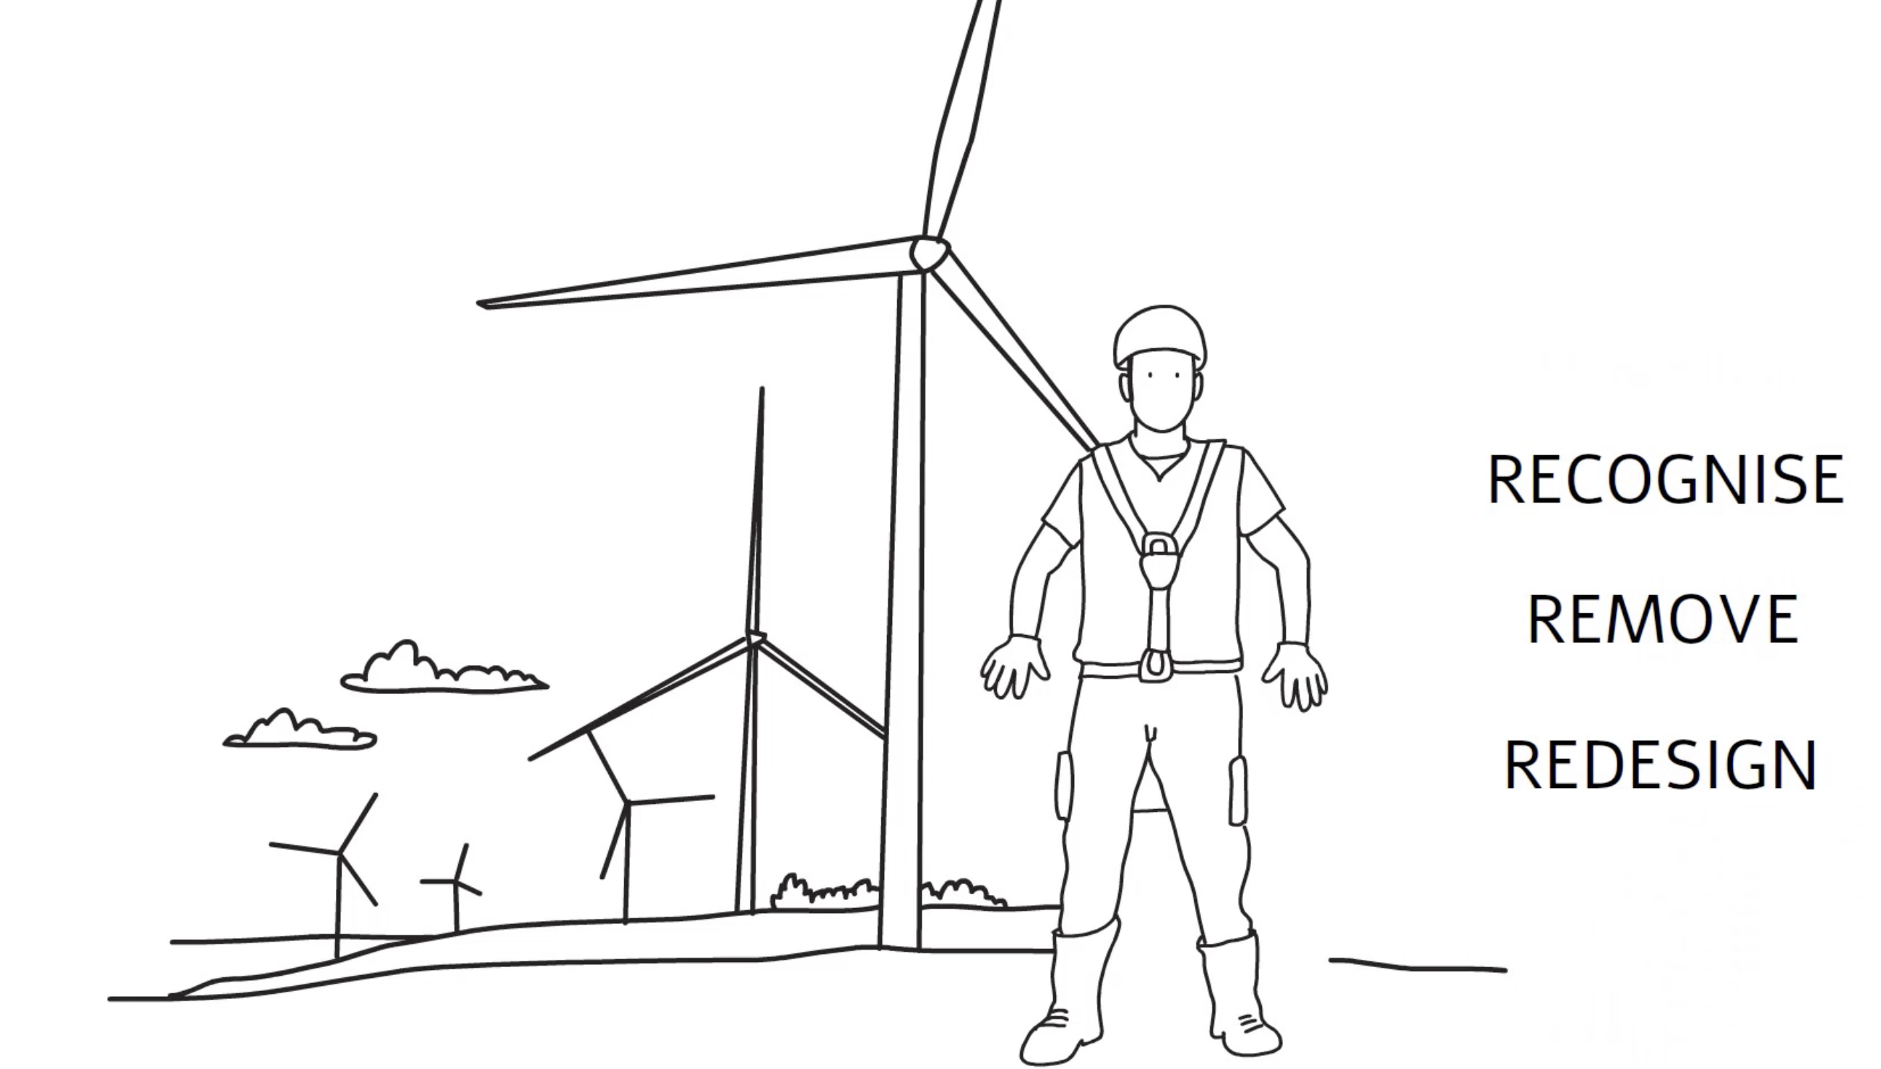
Now let’s take a look at the Recognise, Remove, Redesign video. This is part of a series of videos about
Hand Injuries.
Introduction to Hand Injuries
What types of Hand Injuries are most common in
Onshore Wind?
Upper limb disorders
Carpal Tunnel Syndrome
Hand Arm Vibration Syndrone (HAVS)
Afterwards, we will consider some discussion questions.

Slide 4

Time to talk
What happened?
Why did it happen?
What did they learn?
What questions should they ask?
Notes:
Hand injuries are the most frequent injured body part in the onshore wind industry. Like all injuries – they range in severity. It is important to remember that there are also invisible injuries caused through poor manual handling technique which can cause a lot of pain and discomfort and put you out of work for months at a time. For example: Upper limb disorders; Carpal tunnel disorder, and Hand Arm Vibration.
Poor manual handling technique
Not thinking of the environment, you are working in
Little attention to Recognising, Removing and Redesigning to reduce risk and mitigate injuries
To protect yourself and your colleagues from injuries – apply these three key concepts:
Recognise the risks
Remove the hazards
Redesign your environment and processes when required
What are the hazards in your environment and how can you prevent injury from these things?
How can something like this happen here?
How can we protect you and your colleagues from hand injuries?

Slide 5
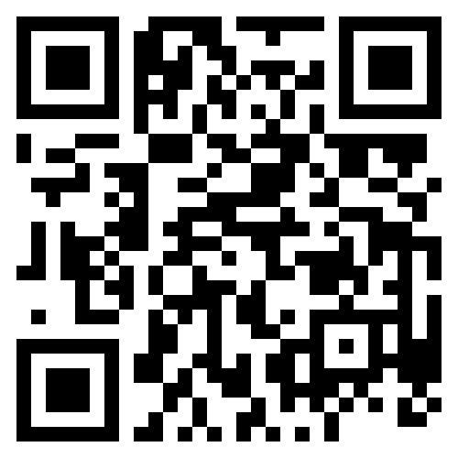
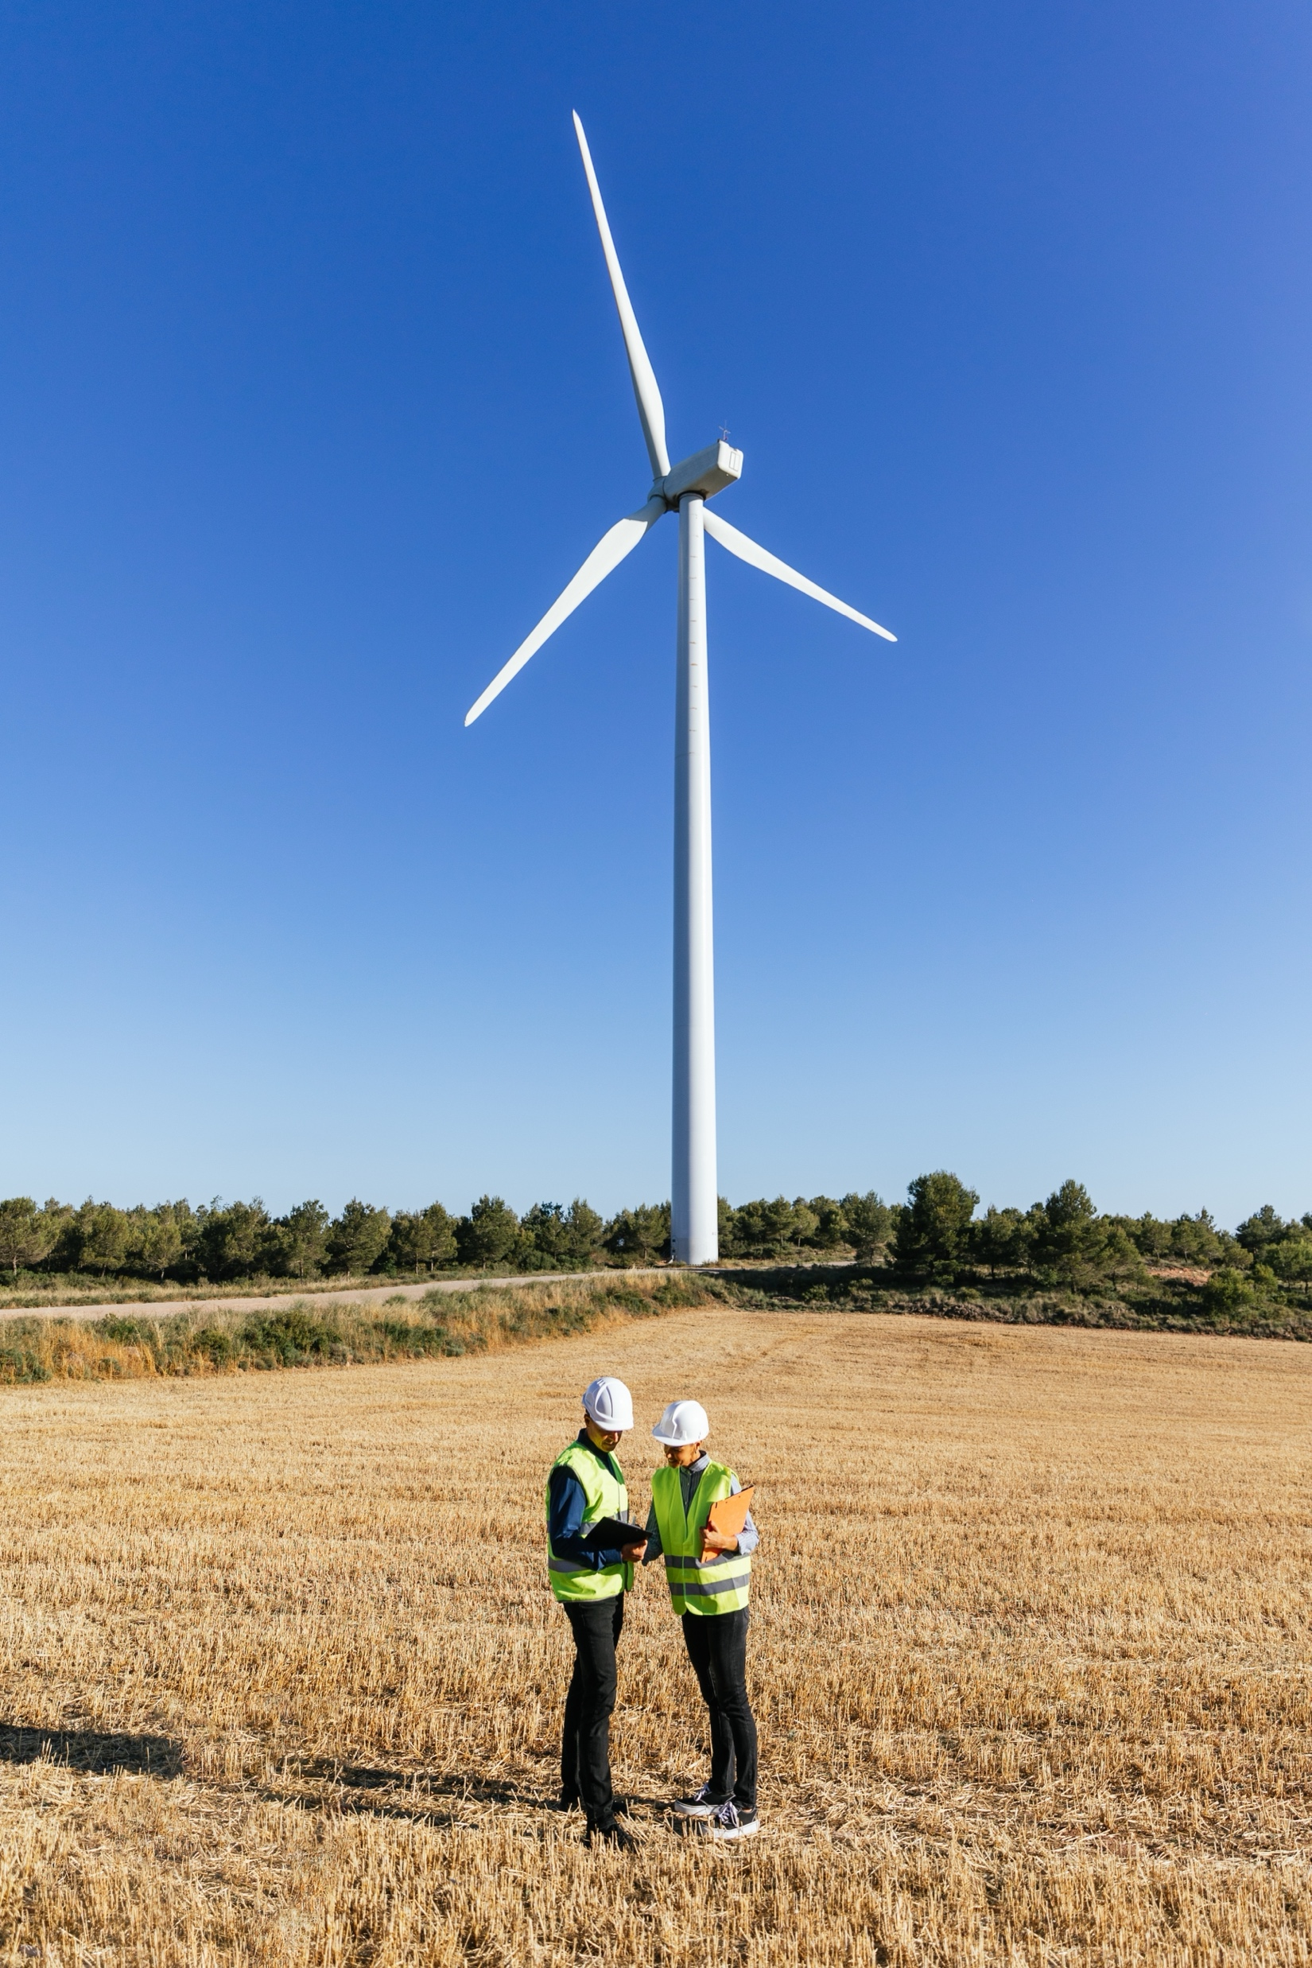
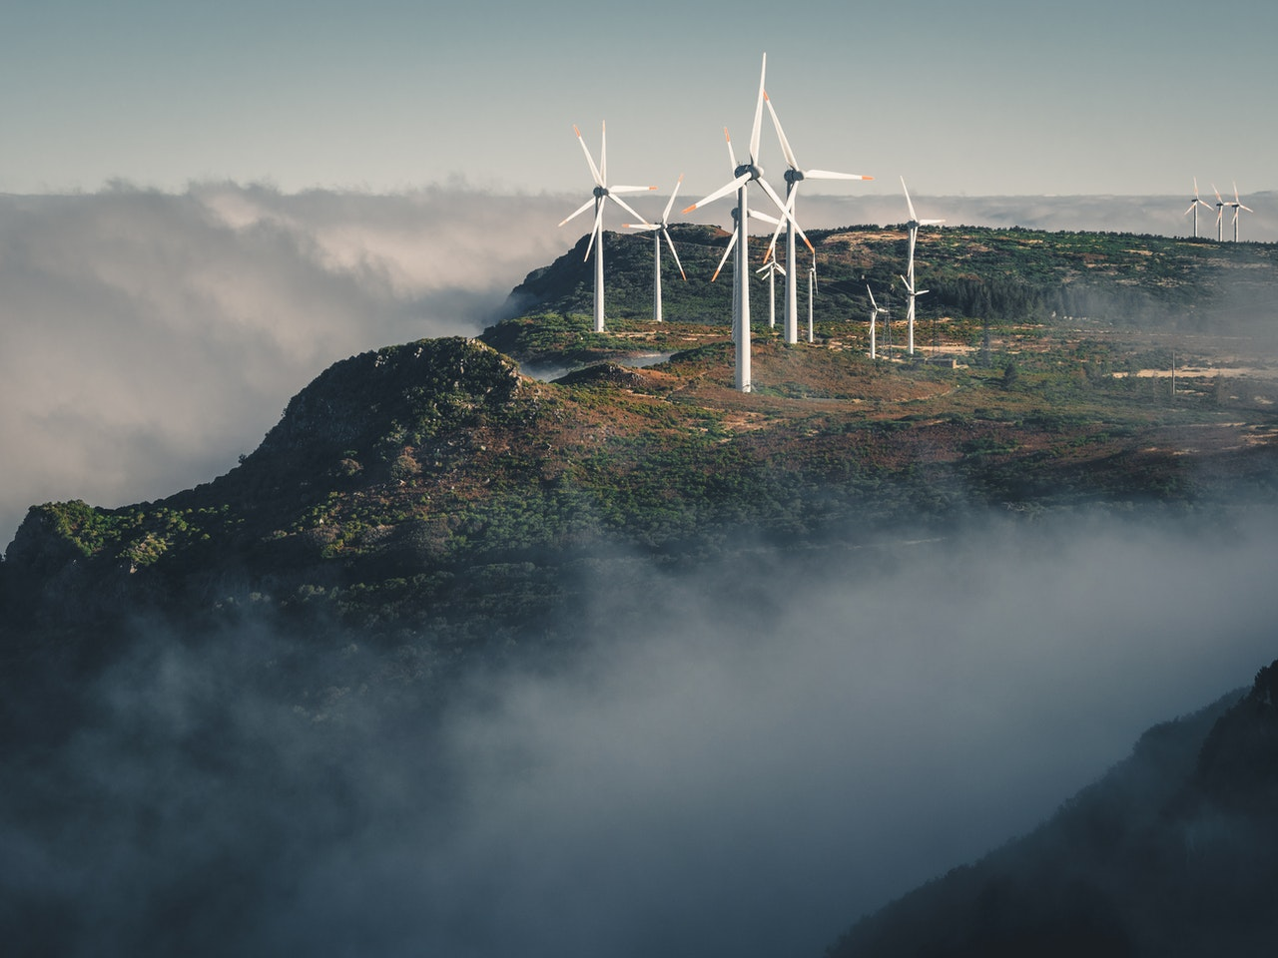



Thank you for being part of
Stand Up For Safety Week
Discover more
Get in touch:
safetyon@energyinst.org
Safetyon.com
Sign up for regular updates on our work

Slide 6
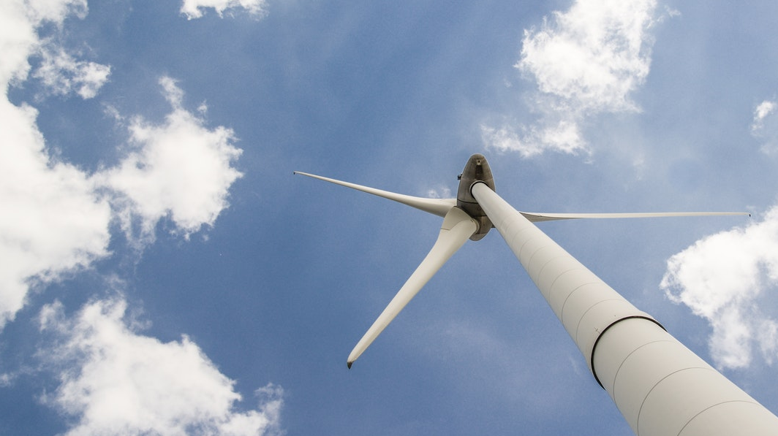


About SafetyOn
Our Mission:
Inspiring a safer and healthier onshore wind industry.
Provide health & safety leadership
Facilitate collaboration within industry and beyond
Gather and monitor data on industry health and safety performance
Share good practice and experience
Our Vision:
Providing advice, sharing best industry practice, promoting, innovation and creating positive change in the UK and Ireland’s onshore wind industry.
Drive knowledge-sharing with adjacent industries
In partnership with
Notes:
Provide health and safety leadership across the onshore wind industry
Seek participation of companies from across the onshore wind industry and partner with relevant trade organisations, consultancies and others
Monitor and gather data on the health and safety performance of the industry
Make use of and ensure effective communication of new and existing good practice and experience both from the UK, Ireland and internationally
Share knowledge and good practice with associated industries, including offshore wind, conventional generation and power networks, in the UK, Ireland and beyond as appropriate

