Slide 1
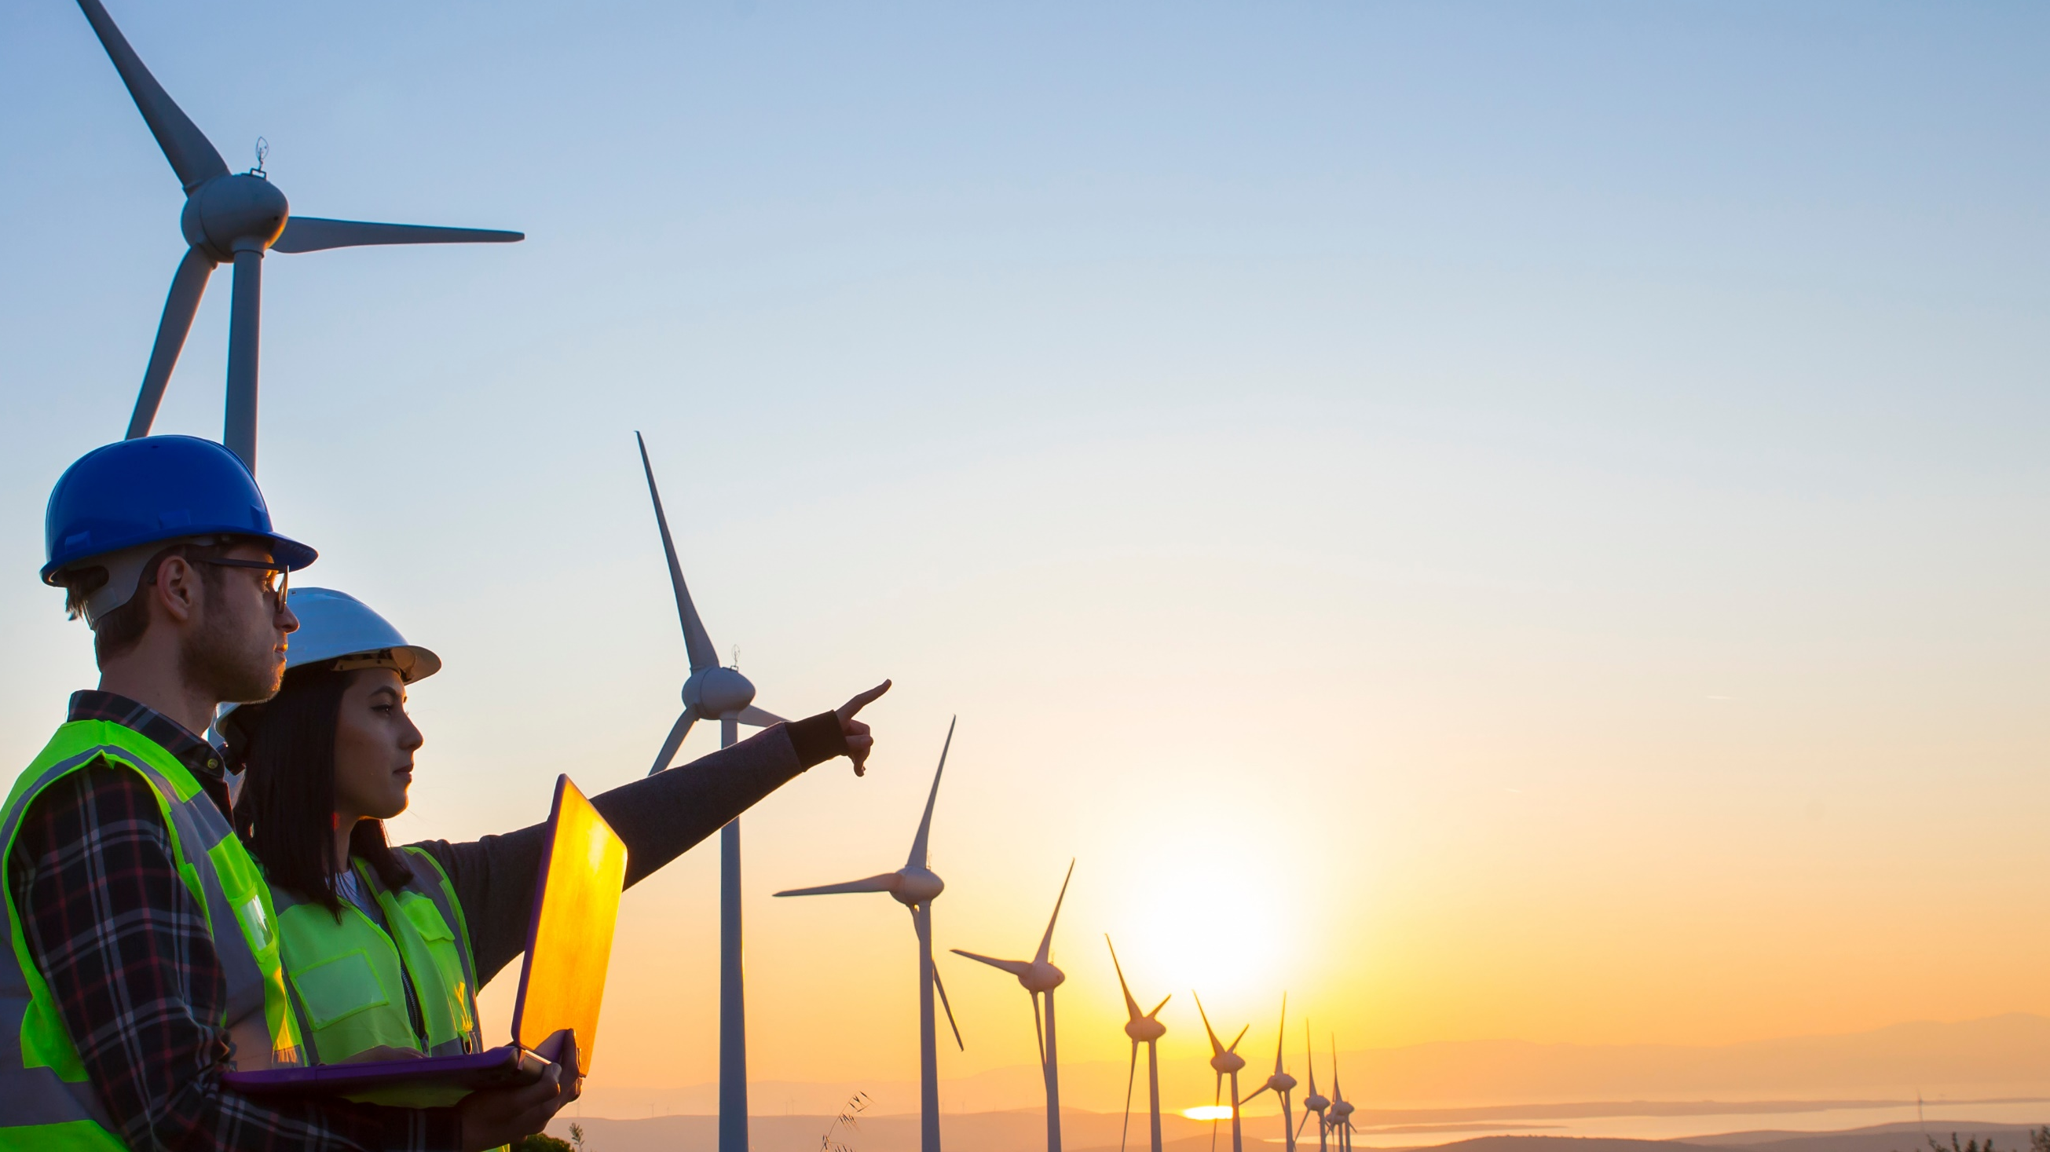

Thank you for being part of
Stand Up For Safety Week
Stand Up For Safety Week is dedicated to creating time to discuss hazards working onshore and preventative measures that could be taken to reduce risk to health and safety.
Stand Up For Safety Week

Slide 2
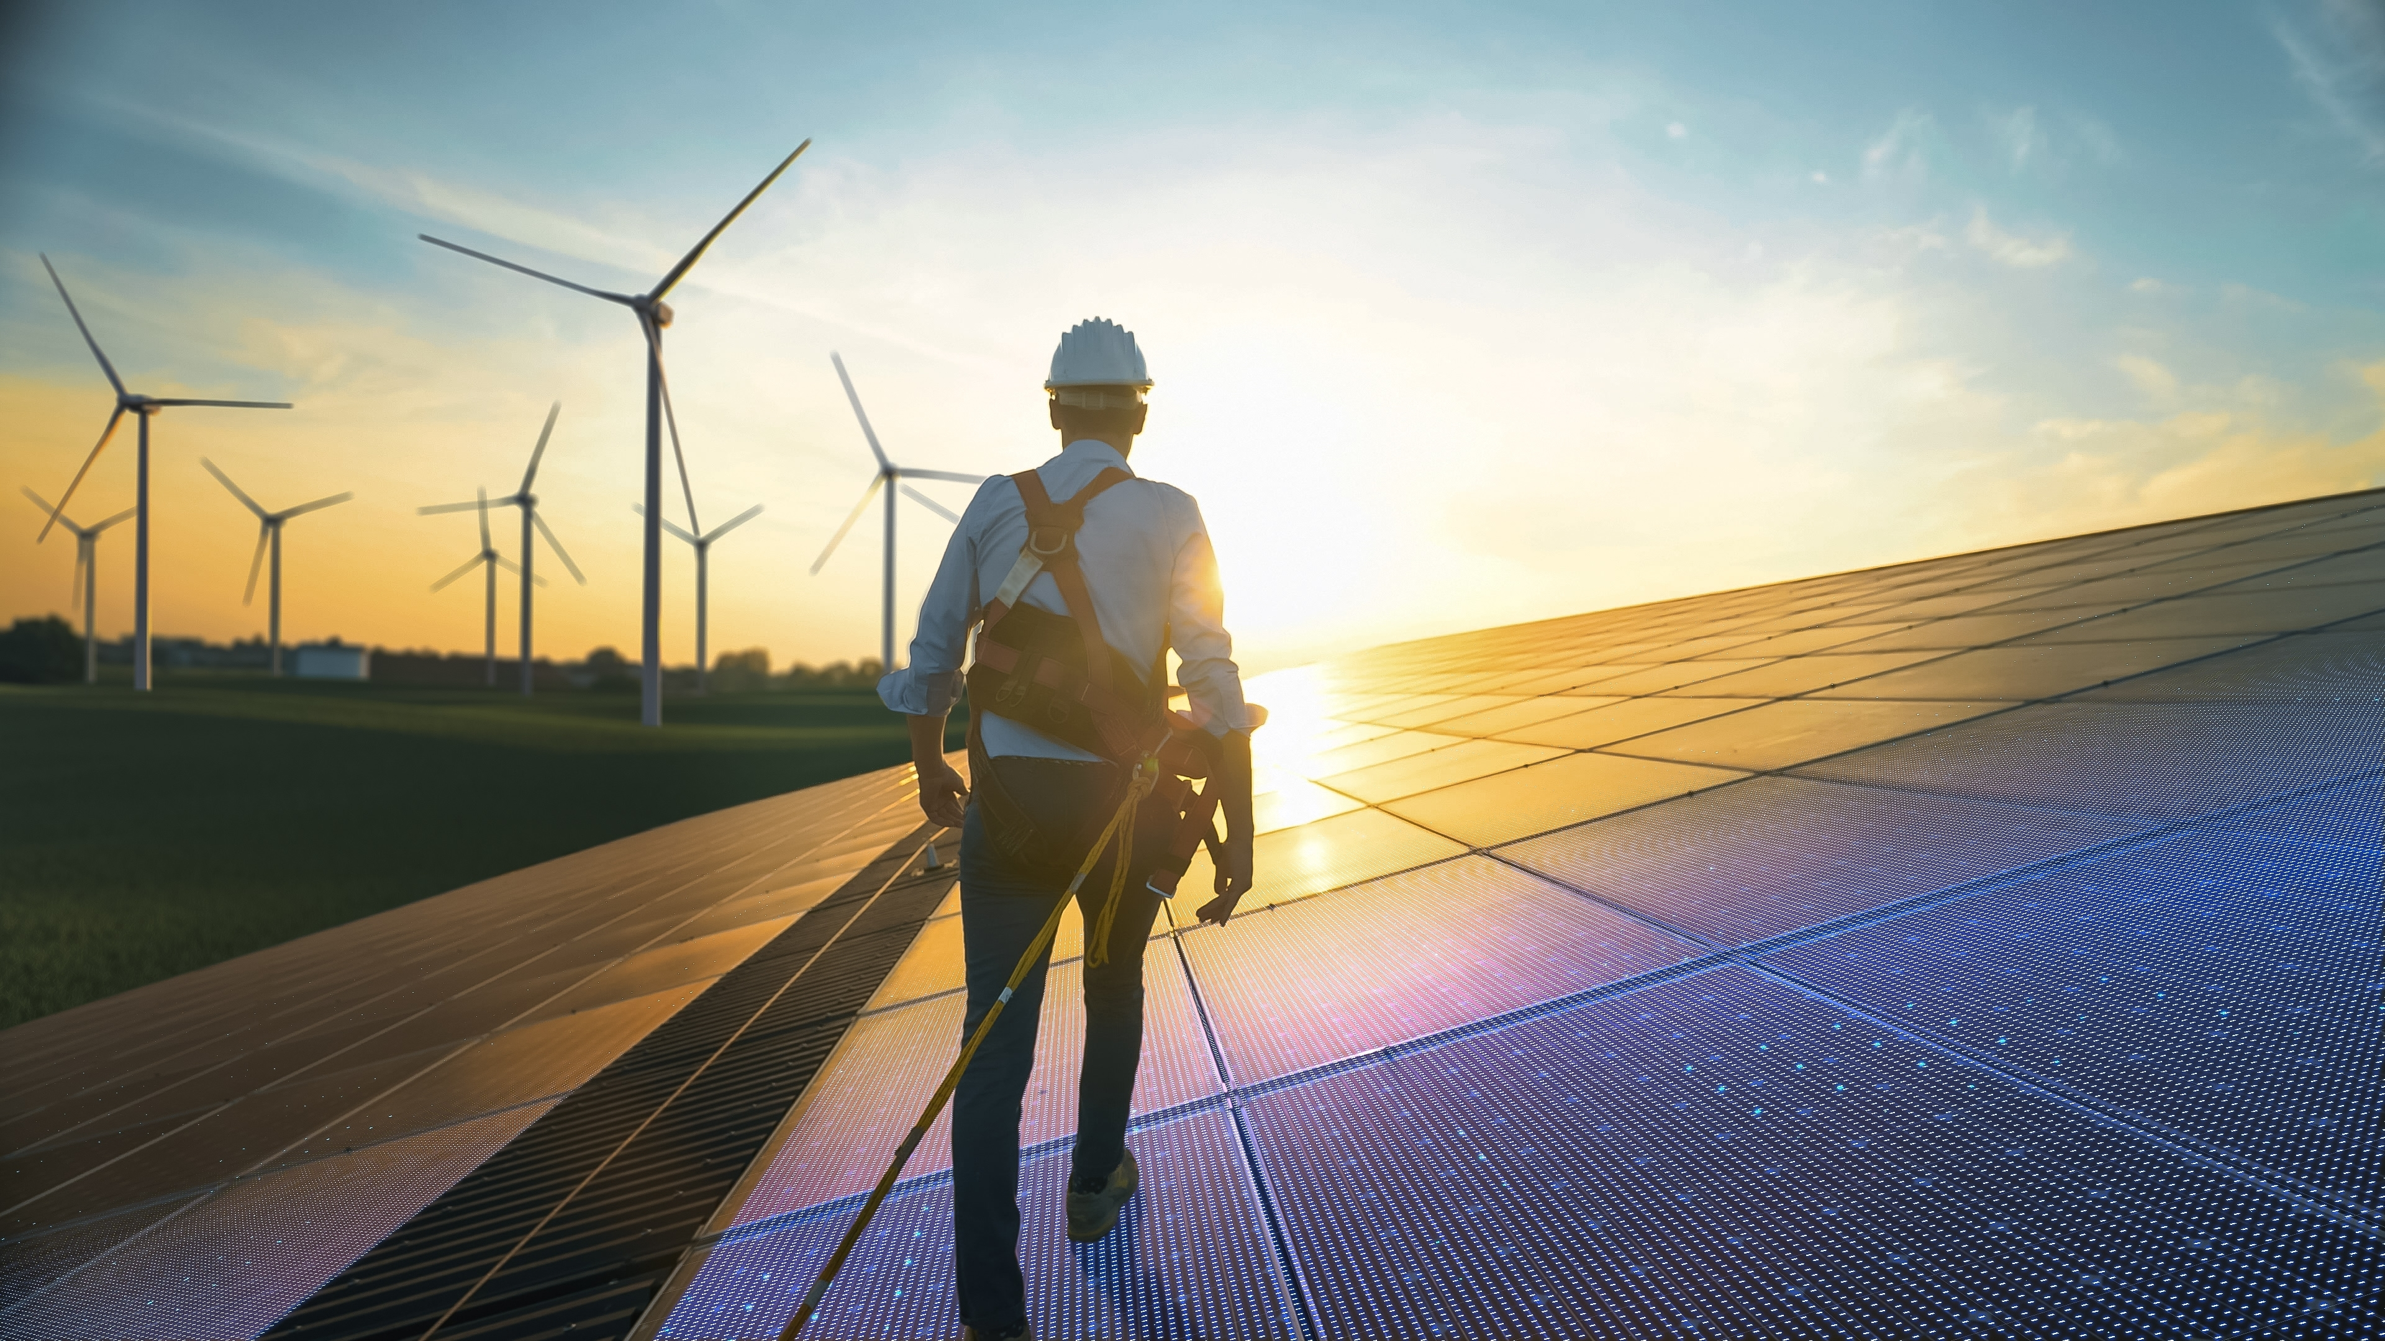
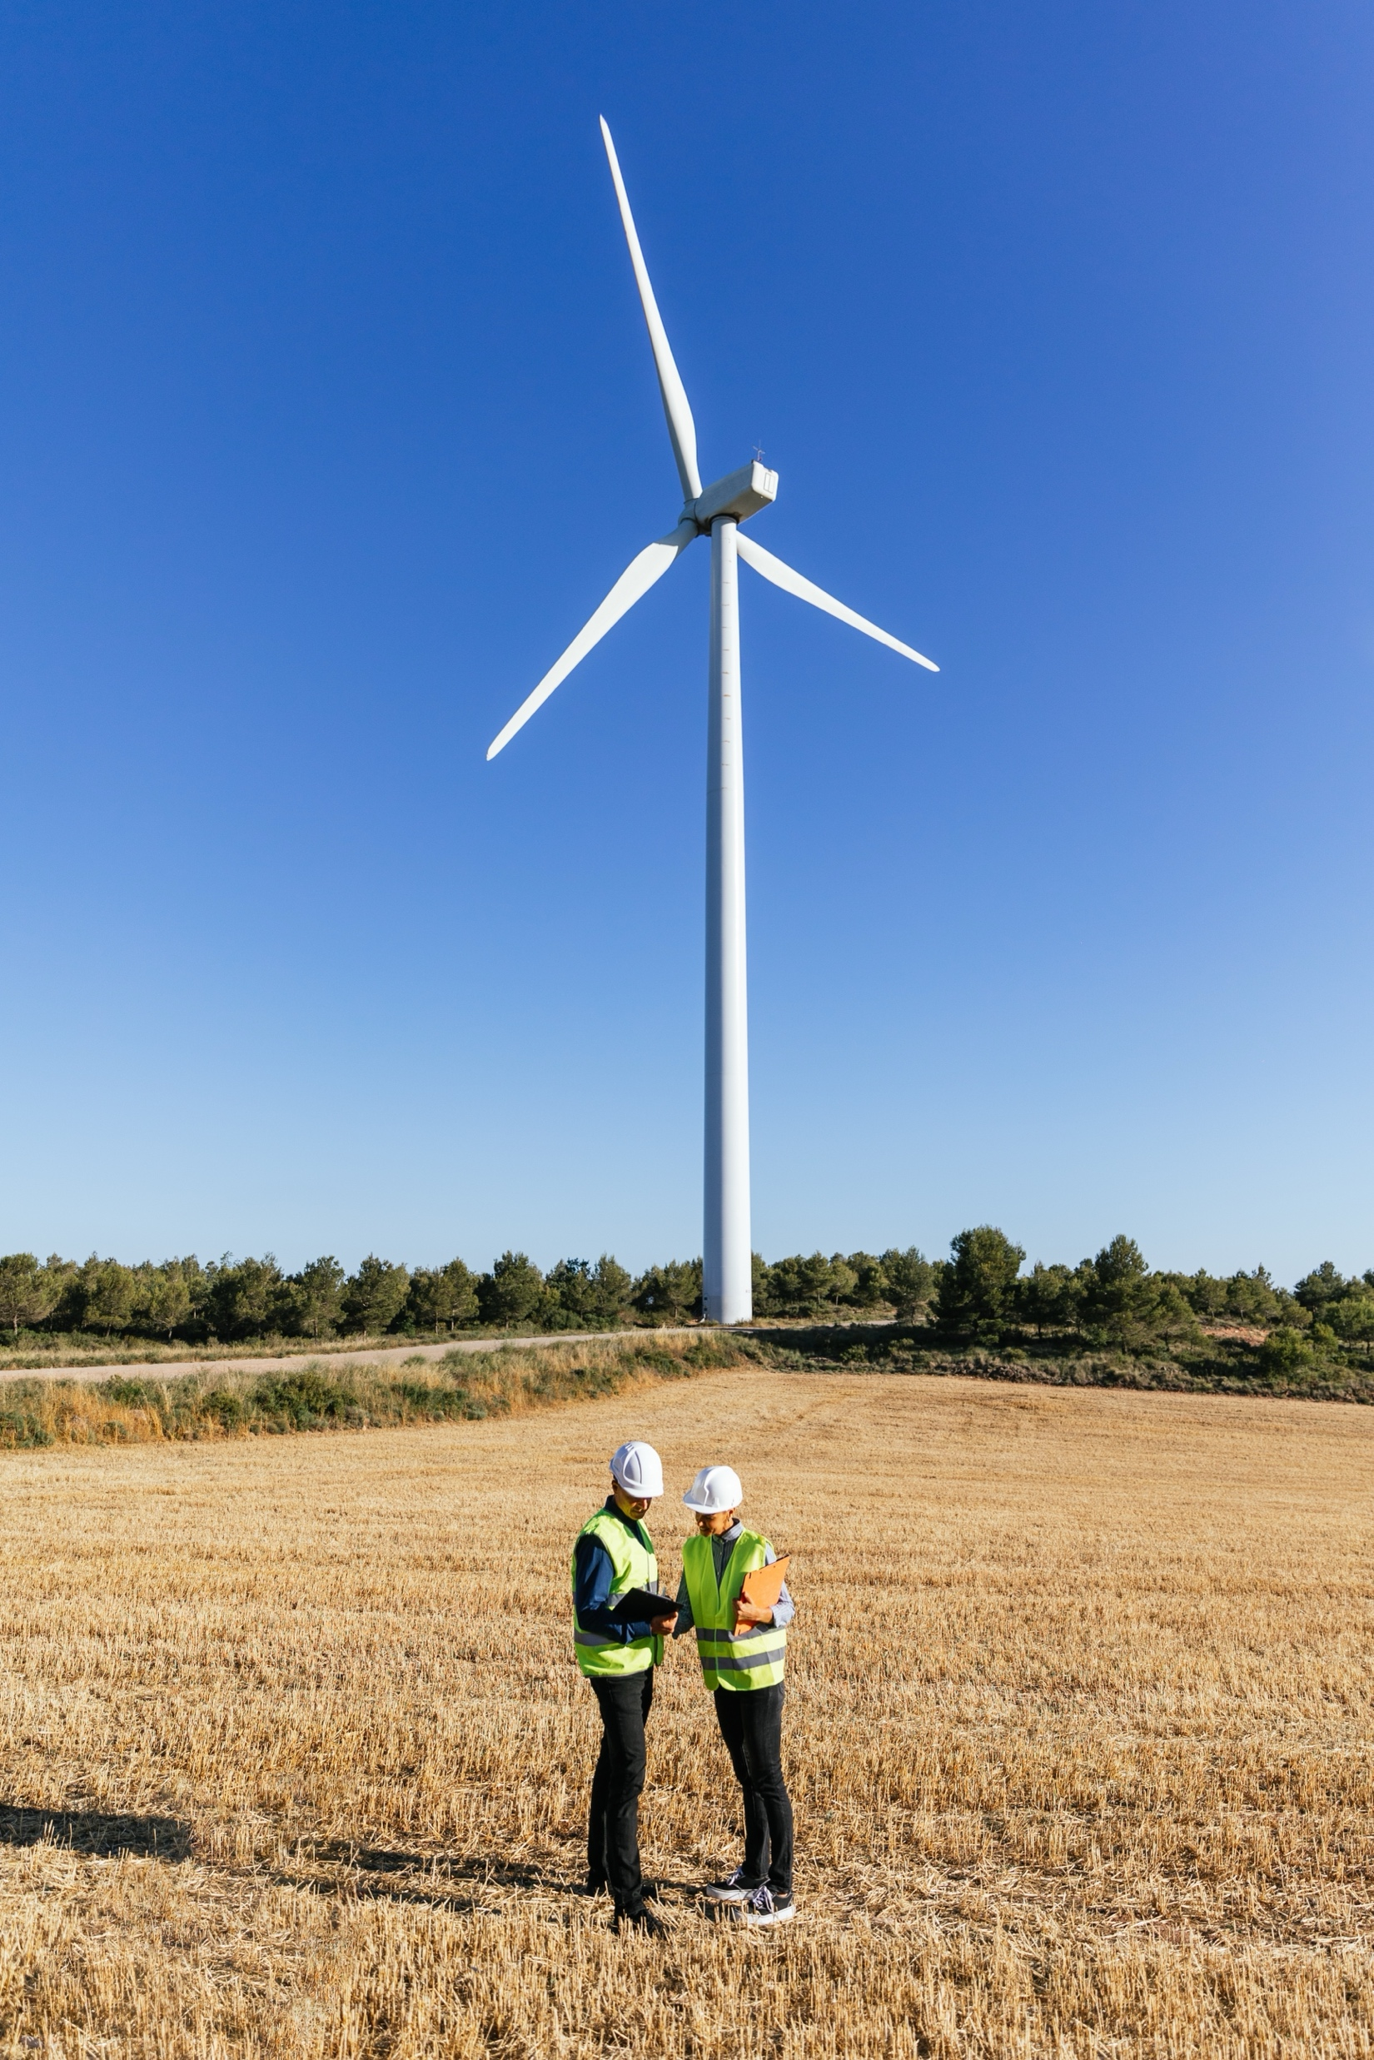
SUFS Briefing Pack:
Manual Handling campaign
Thank you for taking time out to Stand Up For Safety.
Manual Handling is the leading cause of injuries in the Onshore Wind industry.
In partnership with:
In this session:
Intro to Manual Handling
Campaign materials
Discussion questions
Links to additional resources

Slide 3
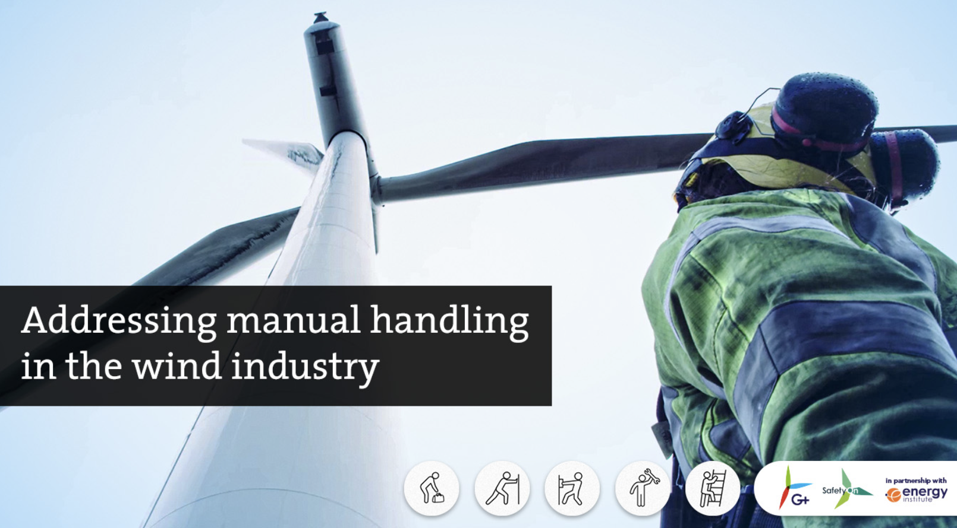
Now let’s take a look at the campaign materials.
Introduction to Manual Handling
How is Manual Handling defined?
Manual handling means transporting or supporting a load by hand or bodily force. It includes lifting, lowering, pushing, pulling, moving
or carrying a load.
(Source: UK HSE)
Afterwards, we will consider some discussion questions.

Slide 4

Time to talk – Key questions
Where do you encounter manual handling in your work tasks?
Why do you think it is the leading cause of injuries?
How can we keep each other safe regarding manual handling in the workplace?
What can be challenging about recognising and acting on manual handling risks?
Notes:
Hand injuries are the most frequent injured body part in the onshore wind industry. Like all injuries – they range in severity. It is important to remember that there are also invisible injuries caused through poor manual handling technique which can cause a lot of pain and discomfort and put you out of work for months at a time. For example: Upper limb disorders; Carpal tunnel disorder, and Hand Arm Vibration.
Poor manual handling technique
Not thinking of the environment, you are working in
Little attention to Recognising, Removing and Redesigning to reduce risk and mitigate injuries
To protect yourself and your colleagues from injuries – apply these three key concepts:
Recognise the risks
Remove the hazards
Redesign your environment and processes when required
What are the hazards in your environment and how can you prevent injury from these things?
How can something like this happen here?
How can we protect you and your colleagues from hand injuries?

Slide 5
Time to talk – Reflections
Have you seen this at work? How would a manual handling culture be reflected?
Do you agree with their definitions of manual handling? What else would you add?
What have you or others done to reduce potential manual handling incidents?
Have you ever experienced a manual handling injury, or a close call?
What considerations do you make in your day-to-day?
Notes:
Hand injuries are the most frequent injured body part in the onshore wind industry. Like all injuries – they range in severity. It is important to remember that there are also invisible injuries caused through poor manual handling technique which can cause a lot of pain and discomfort and put you out of work for months at a time. For example: Upper limb disorders; Carpal tunnel disorder, and Hand Arm Vibration.
Poor manual handling technique
Not thinking of the environment, you are working in
Little attention to Recognising, Removing and Redesigning to reduce risk and mitigate injuries
To protect yourself and your colleagues from injuries – apply these three key concepts:
Recognise the risks
Remove the hazards
Redesign your environment and processes when required
What are the hazards in your environment and how can you prevent injury from these things?
How can something like this happen here?
How can we protect you and your colleagues from hand injuries?

Slide 6
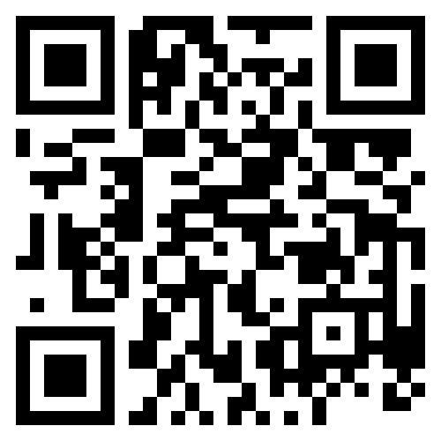
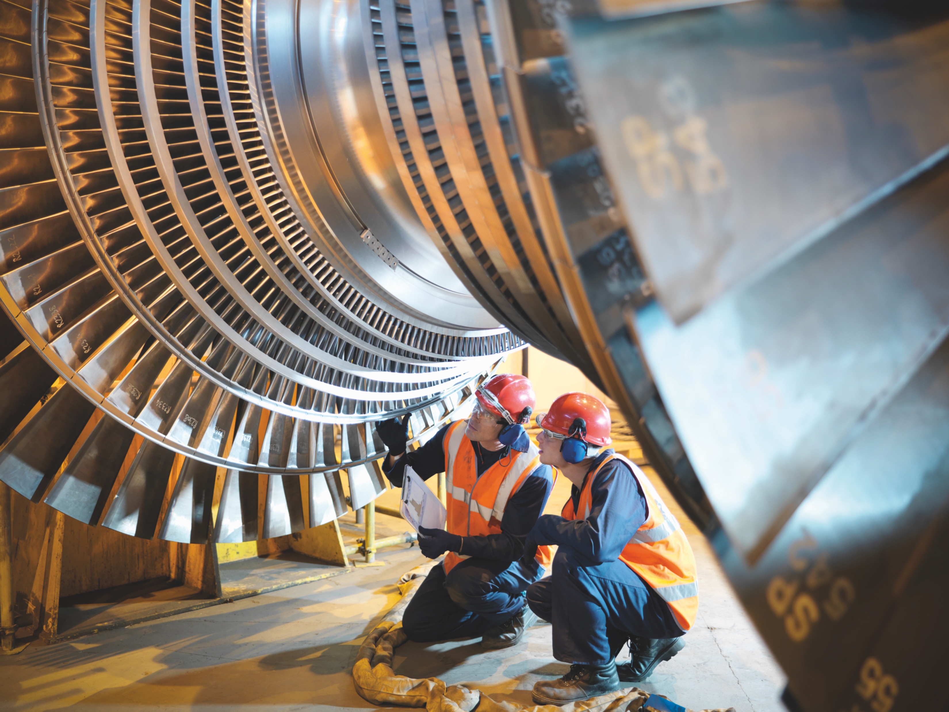



Thank you for being part of
Stand Up For Safety Week
Discover more
Get in touch:
safetyon@energyinst.org
Safetyon.com
Sign up for regular updates on our work

Slide 7
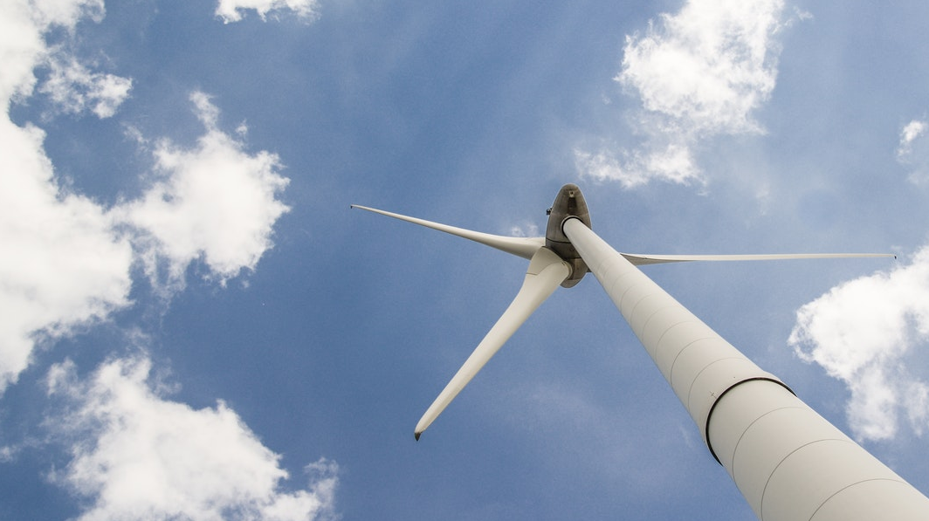


About SafetyOn
Our Mission:
Inspiring a safer and healthier onshore wind industry.
Provide health & safety leadership
Facilitate collaboration within industry and beyond
Gather and monitor data on industry health and safety performance
Share good practice and experience
Our Vision:
Providing advice, sharing best industry practice, promoting, innovation and creating positive change in the UK and Ireland’s onshore wind industry.
Drive knowledge-sharing with adjacent industries
In partnership with
Notes:
Provide health and safety leadership across the onshore wind industry
Seek participation of companies from across the onshore wind industry and partner with relevant trade organisations, consultancies and others
Monitor and gather data on the health and safety performance of the industry
Make use of and ensure effective communication of new and existing good practice and experience both from the UK, Ireland and internationally
Share knowledge and good practice with associated industries, including offshore wind, conventional generation and power networks, in the UK, Ireland and beyond as appropriate

