Slide 1


Thank you for being part of
Stand Up For Safety Week
Stand Up For Safety Week is dedicated to creating time to discuss hazards working onshore and preventative measures that could be taken to reduce risk to health and safety.
Stand Up For Safety Week

Slide 2

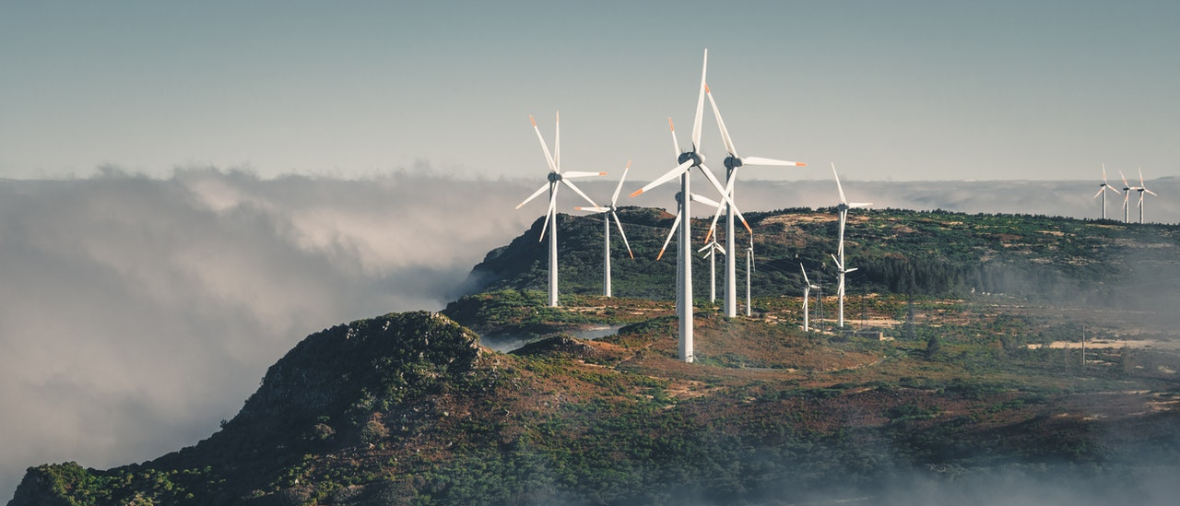

SUFS Briefing Pack:
Human Factors eBook
Thank you for taking time out to Stand Up For Safety.
The theme of this year’s event is Human Factors.
In partnership with:
In this session:
Intro to Human Factors
Human Factors eBook
Discussion questions
Links to additional resources

Slide 3

Introduction to Human Factors
What do we mean by “Human Factors?”
Now let’s take a look at the eBook, “Human Factors in Renewables”.
Afterwards, we will consider some discussion questions.
The psychological, cultural, behavioural and other human attributes that influence decision-making, the flow of information and the interpretation of information by individuals and groups.
Afterwards, we will consider some discussion questions.

Slide 4

Time to talk - Leadership
DESIGN
How can we design jobs, equipment, and procedures to fit human capabilities (ergonomics) rather than forcing people to adapt?
TRAINING
How can we better train and support workers to manage their own human factors (e.g., stress management, fatigue awareness)?
SYSTEMS
What supports or systems could we implement to make complex tasks safer and reduce reliance on perfect performance?
LEADERSHIP
What role does leadership play in creating an environment where human factors are managed effectively?
REPORTING
And, when an incident happens, are we asking:
Why the human factors existed, not just what happened?
How does our safety culture either encourage or discourage reporting issues and speaking up?

Slide 5
Time to talk – Operational
TOP RISKS
What tasks in our workplace are most prone to human error, and why?
FITNESS FOR WORK
How do factors like fatigue, stress, or distractions affect performance and safety here?
ENVIRONMENTAL
What are the key environmental (layout, tools) and organizational (shifts, workload) influences on our team's safety?
CULTURE
Beyond rules, what cultural shifts are needed to make safety a shared, proactive value?
REPORTING
And, when an incident happens, are we asking:
Did recent changes (new equipment, policy, staffing) contribute to the event?
Were management objectives clear, or did they create conflicting demands that increased risk?

Slide 6
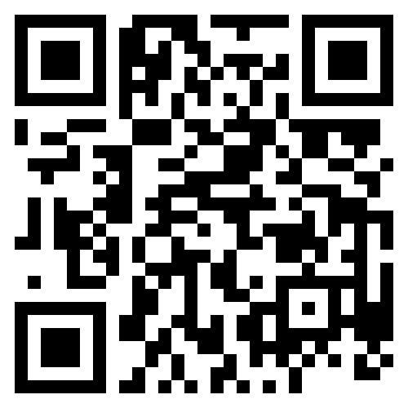
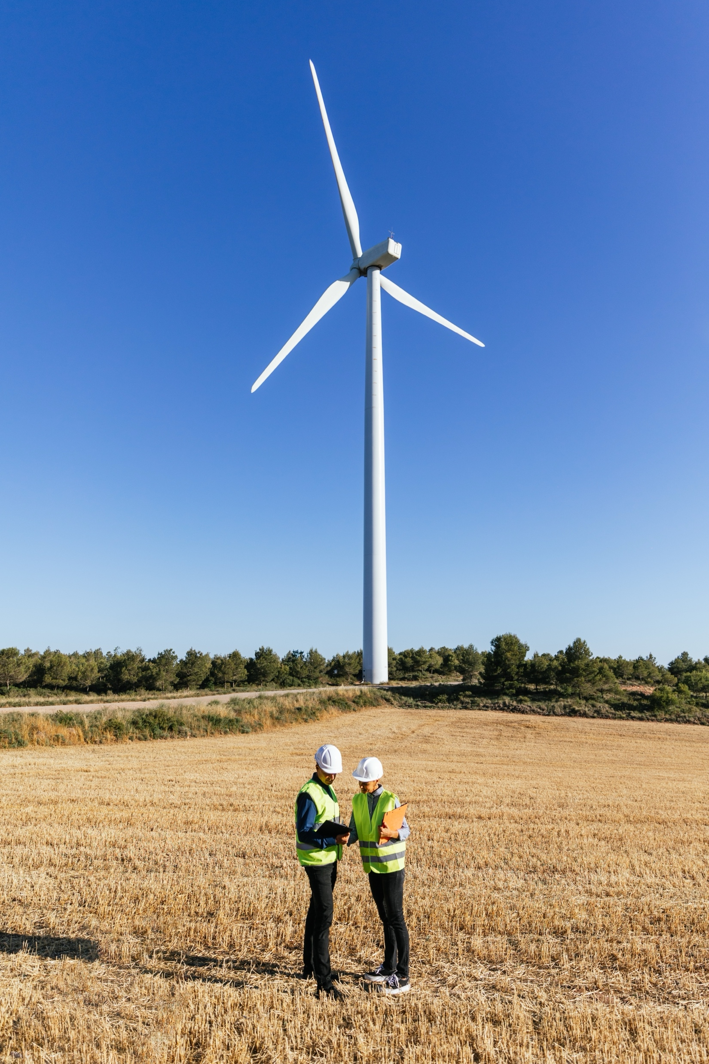
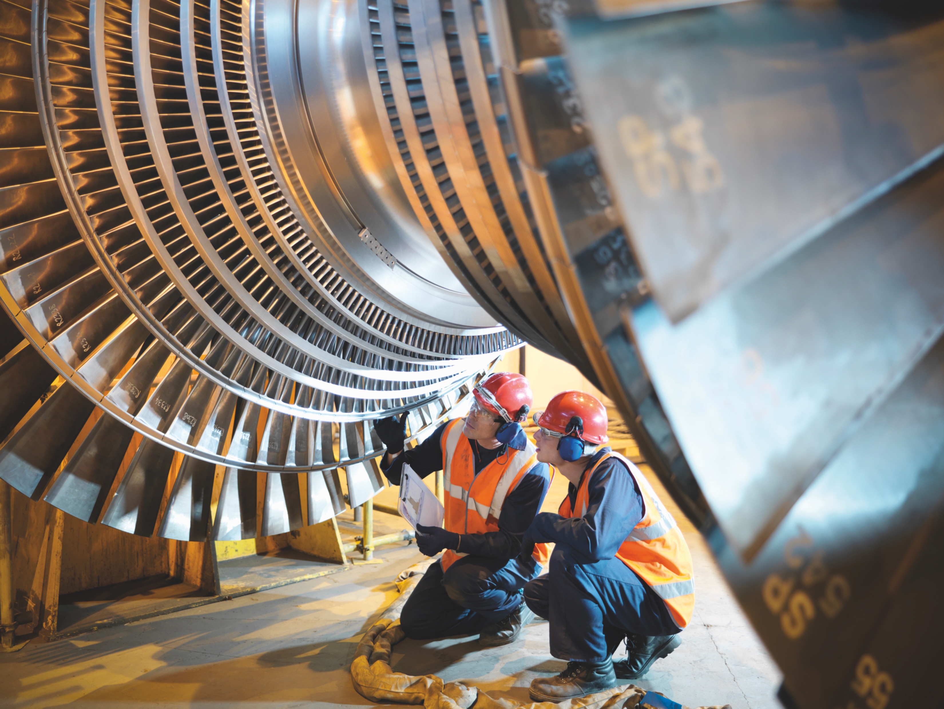



Thank you for being part of
Stand Up For Safety Week
Discover more
Get in touch:
safetyon@energyinst.org
Safetyon.com
Sign up for regular updates on our work

Slide 7
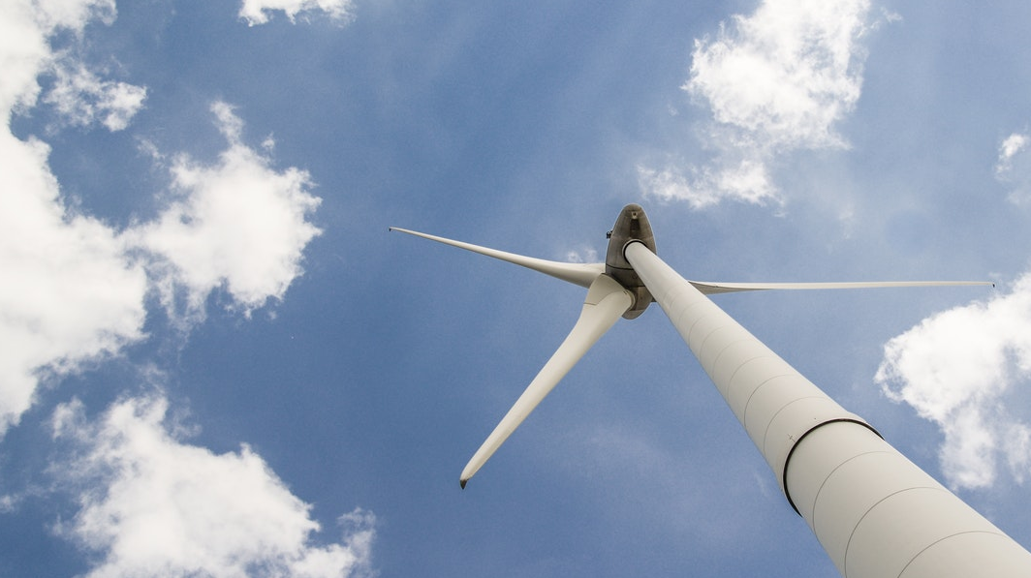

About SafetyOn
Our Mission:
Inspiring a safer and healthier onshore wind industry.
Provide health & safety leadership
Facilitate collaboration within industry and beyond
Gather and monitor data on industry health and safety performance
Share good practice and experience
Our Vision:
Providing advice, sharing best industry practice, promoting, innovation and creating positive change in the UK and Ireland’s onshore wind industry.
Drive knowledge-sharing with adjacent industries
In partnership with
Notes:
Provide health and safety leadership across the onshore wind industry
Seek participation of companies from across the onshore wind industry and partner with relevant trade organisations, consultancies and others
Monitor and gather data on the health and safety performance of the industry
Make use of and ensure effective communication of new and existing good practice and experience both from the UK, Ireland and internationally
Share knowledge and good practice with associated industries, including offshore wind, conventional generation and power networks, in the UK, Ireland and beyond as appropriate

